Slide 1
End-to-End Speech Translation
Jan Niehues, Elizabeth Salesky, Marco Turchi and Matteo Negri
EACL 2021

Slide 2
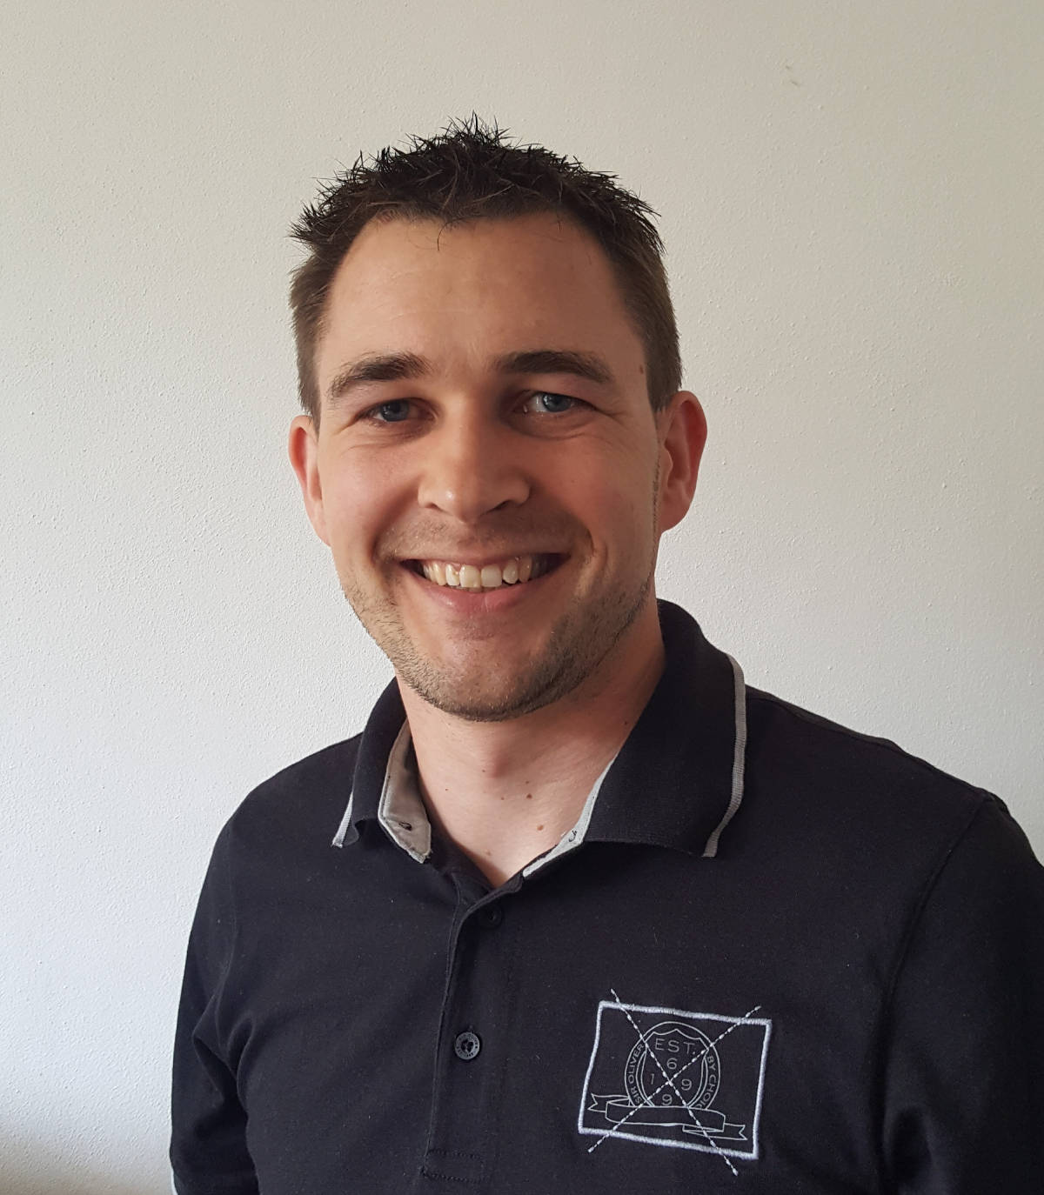
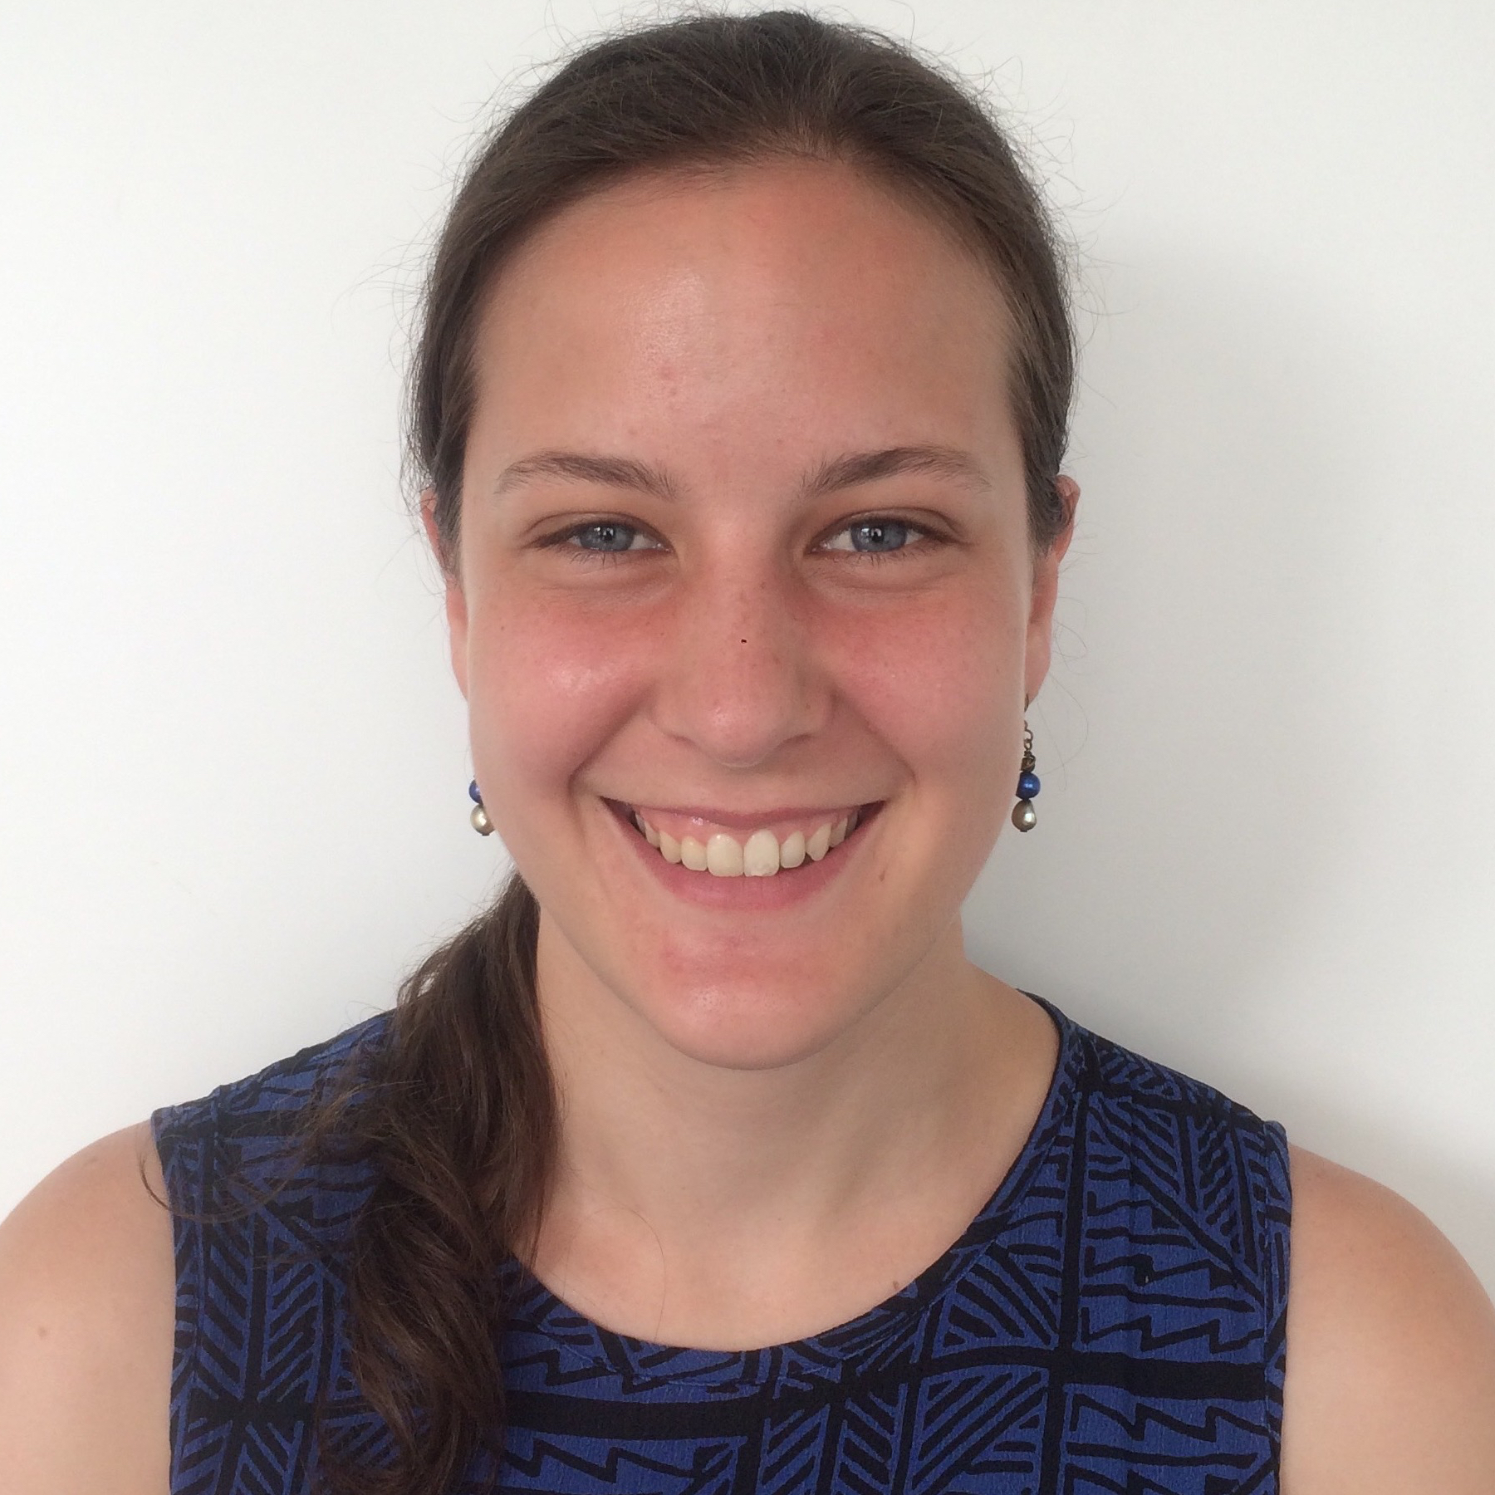
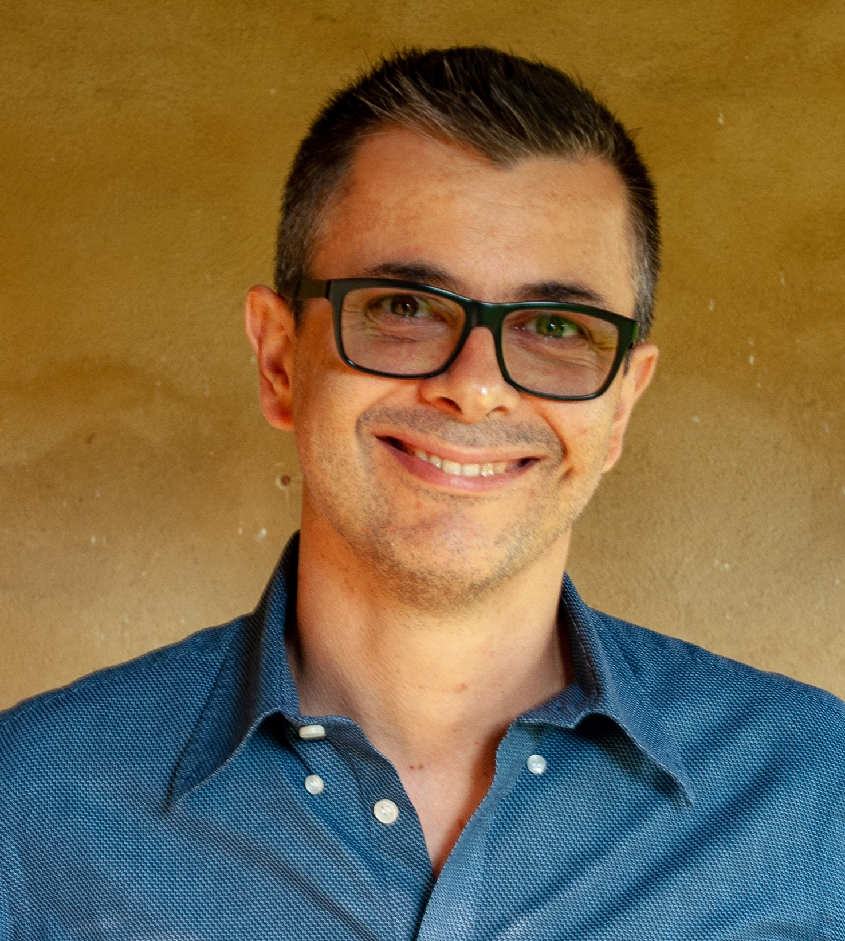
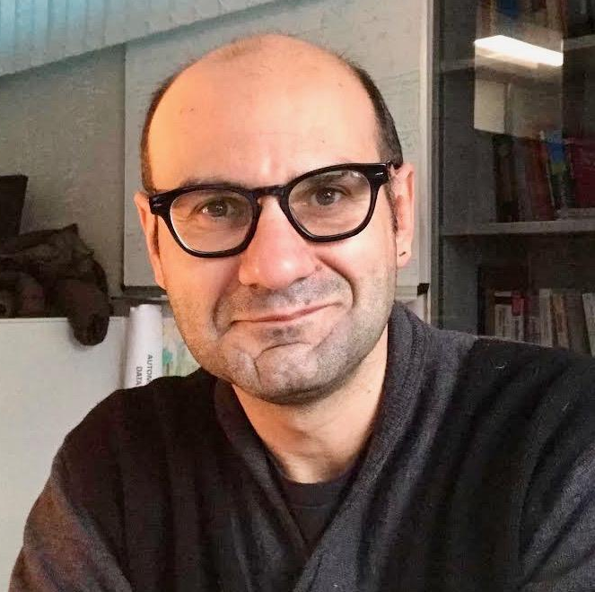
Speakers
Jan Niehues,
Maastricht University
jan.niehues@maastrichtuniversity.nl
Elizabeth Salesky,
Johns Hopkins University
esalesky@jhu.edu
Marco Turchi,
Fondazione Bruno Kessler
turchi@fbk.eu
Matteo Negri,
Fondazione Bruno Kessler
negri@fbk.eu

Slide 3
Outline
Sec 1: Introduction | 1.1: Task definition
 | 1.2: Challenges in translation of speech
 | 1.3: Traditional cascade approach
Sec 2: End-to-End | 2.1: State-of-the-art
 | 2.2: Input representations
 | 2.3: Architecture & modifications
 | 2.4: Output representations
Sec 3: Leveraging Data Sources | 3.1: Available data
 | 3.2: Techniques: Multi-task learning
 | Transfer-learning & pretraining
 | Knowledge distillation
 | 3.3: Alternate data representations
Sec 4: Evaluation | 4.1: Automatic Metrics
 | 4.2: Utterance segmentation
 | 4.3: Mitigating error – gender bias
Sec 5: Advanced Topics | 5.1: Utterance segmentation
 | 5.2: Multilingual ST
 | 5.3: Under-resourced languages
Sec 6: Real-world | 6.1: Automatic generation of subtitles
 | 6.2: Simultaneous translation
Sec 7: Conclusion | 🏆

Slide 4
Sec 1:
Introduction
Task definition
Challenges in translation of speech
Traditional cascade approaches

Slide 5
Sec 1.1
Task Definition

Slide 6
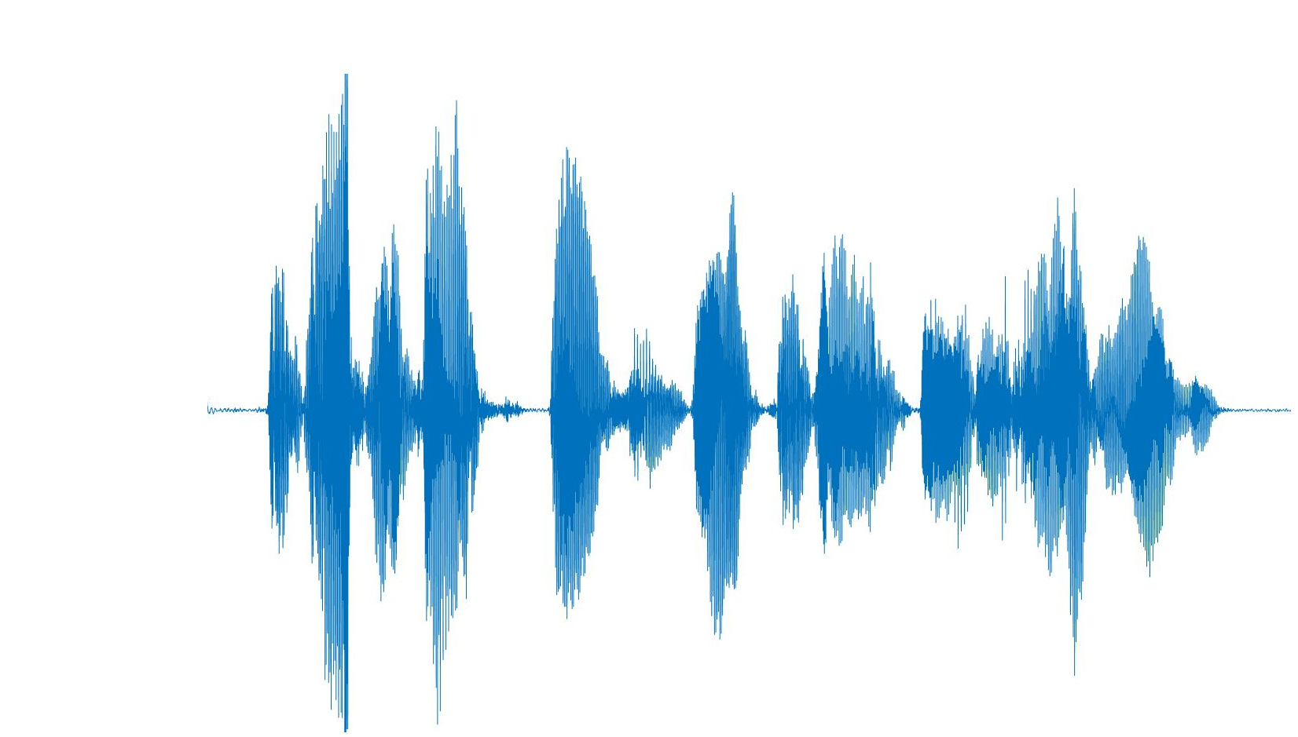
Speech Translation - Task
Speech input
= Welcome to this tutorial
ST system
Willkommen zu diesem Tutorial
Textual translation
Spoken translation
Notes:
Converting an input utterance in one language into its translation in a different language. The translation can be either presented in textual form or as synthesized speech.

Slide 7
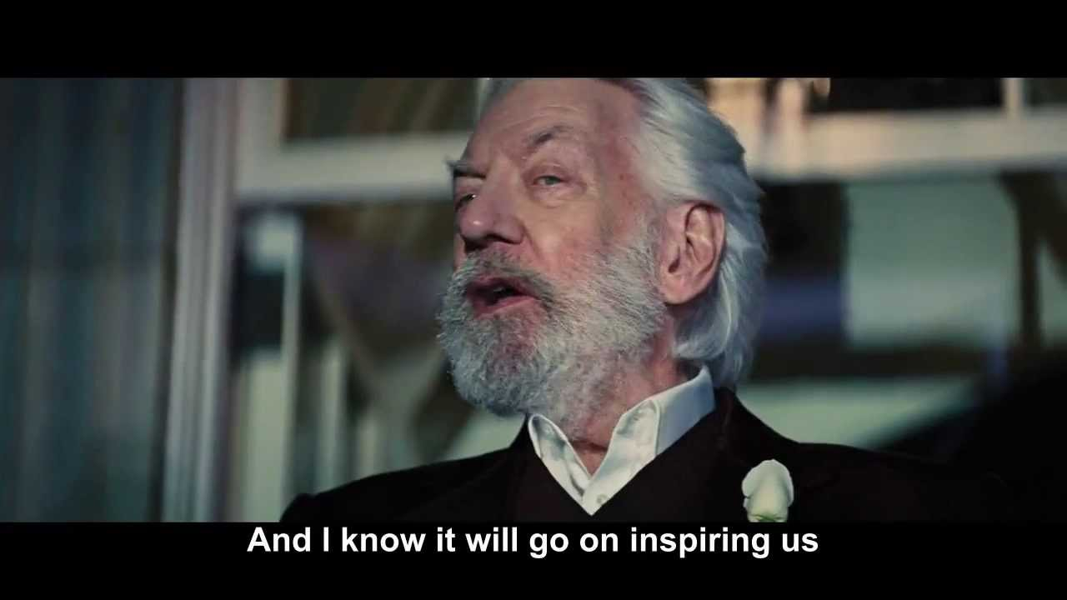
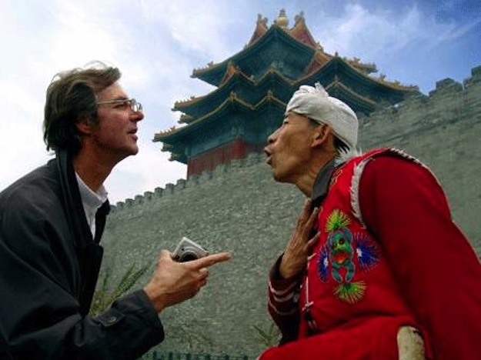
Speech Translation - Motivation
Break language barriers to communicate, spread information and culture
Work
Meetings
Education and training
Lectures, conferences
Entertainment
Youtube, social media, cinema, tv
Everyday communication
Tourism, medical care, telephone conversations

Slide 8
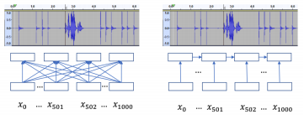
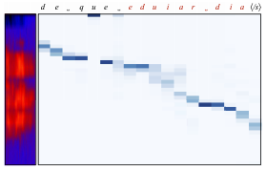
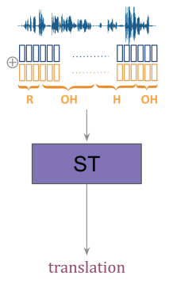
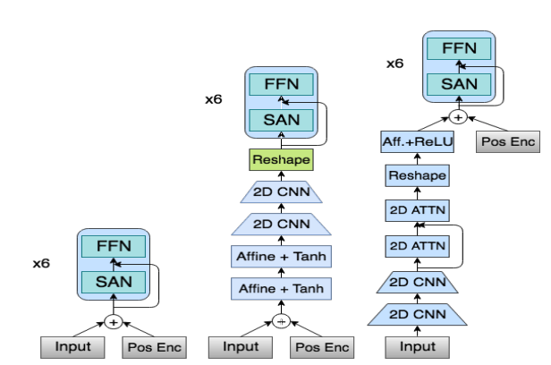
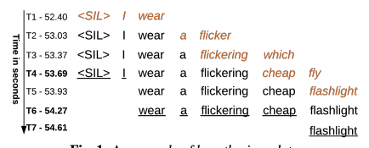
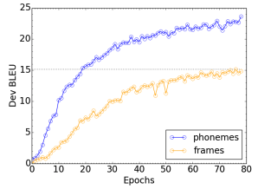
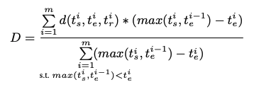
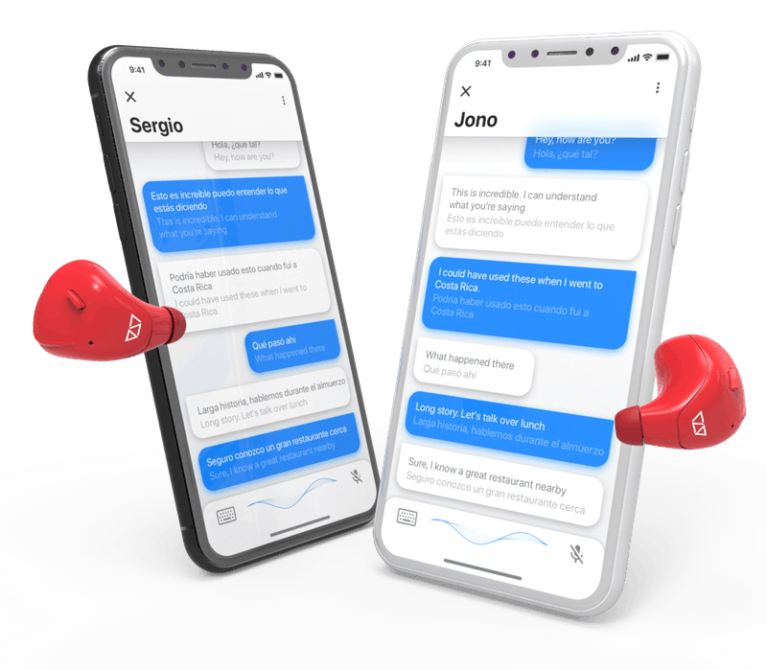
Speech Translation - Motivation
Room for advanced research...
99% of this tutorial
...and for applications
Wearable devices
Video subtitling
Live captioning
Human-machine communication
Notes:
Why is it interesting? Because...

Slide 9
Speech Translation - History (before e2e)
Late ‘80s: first proofs of concept
Constraints to control language ambiguity (phonetics, syntax, semantics)
Restricted vocabulary
Controlled speaking style
Narrow domain
Offline processing
‘90s: Less constraints (vocabulary, speaking style)
First spontaneous ST systems (C-STAR, Verbmobil, Nespole,...)
2003-2006: Less constraints (domain)
First open-domain ST systems (STR-DUST, TC-STAR, GALE)
different scenarios (broadcast news, parliamentary speeches, academic lectures)
different languages (Zh, Ar, Es)
2006: Less constraints (operating conditions)
First simultaneous translator
(real-time translation of spontaneous lectures and presentations)

Slide 10
Speech Translation - History (the e2e era)
2005: first ST corpora
Small size/language coverage
2016-2017: first e2e ST models
(Duong et al., 2016, Berard et al., 2016, Weiss et al., 2017, ...)
encoder-decoder architectures based on RNNs
2018: first e2e models at IWSLT
8.7 BLEU points below cascade ST solutions on En-De
2019: significant gap reduction at IWSLT
1.6 BLEU points below cascade ST solutions on En-De
2019: ST adaptation of Transformer
(Di Gangi et al., 2019)
2019-2020: new ST corpora
Larger size/language coverage
2020: the gap almost closed?
+0.24 BLEU on unsegmented En-De test data

Slide 11
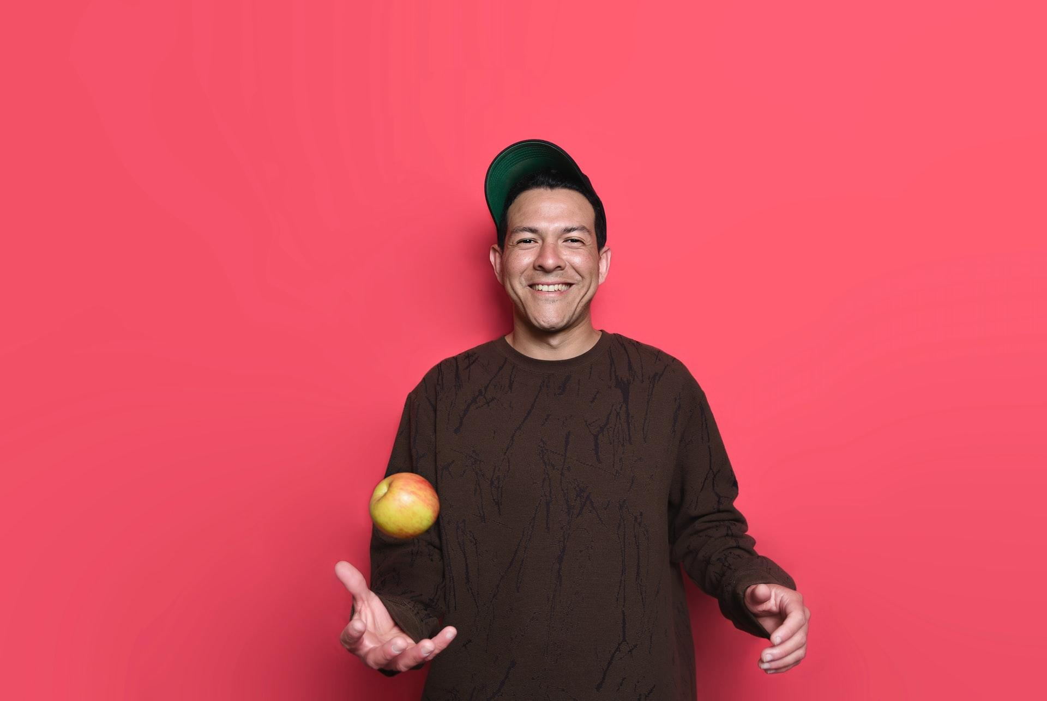
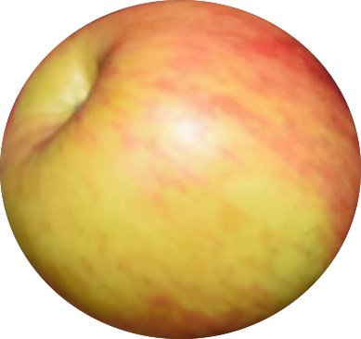
Speech Translation - a Multi-faceted Problem
difficulty
Notes:
ST is a multi-faceted problem, whose complexity can depend on a number of factors.

Slide 12
Speech Translation - a Multi-faceted Problem
Offline
Simultaneous
Single-speaker
difficulty
Multi-speaker
Clean audio
Noisy conditions
Restricted domain
Open domain
Resource-rich languages
Under-resourced languages
Low speaker variety (gender, accent, ...)
High speaker variety
Unconstrained
Constrained (e.g. subtitling)
...
...
Notes:
Operating conditions 1. offline/simult., 2. number of speakers, 3. audio quality
Domain and training data 4. restricted/open, 5. resource-rich/under-resourced, 6. low/high speaker variety
Output type 7. unconstr./const.

Slide 13
Speech Translation - a Multi-faceted Problem
Offline
Simultaneous
Single-speaker
difficulty
Multi-speaker
Clean audio
Noisy conditions
Restricted domain
Open domain
Resource-rich languages
Under-resourced languages
Low speaker variety (gender, accent, ...)
High speaker variety
Unconstrained
Constrained (e.g. subtitling)
...
...
Notes:
Operating conditions 1. offline/simult., 2. number of speakers, 3. audio quality
Domain and training data 4. restricted/open, 5. resource-rich/under-resourced, 6. low/high speaker variety
Output type 7. unconstr./const.

Slide 14
Speech Translation - a Multi-faceted Problem
Offline
Simultaneous
Single-speaker
difficulty
Multi-speaker
Clean audio
Noisy conditions
Restricted domain
Open domain
Resource-rich languages
Under-resourced languages
Low speaker variety (gender, accent, ...)
High speaker variety
Unconstrained
Constrained (e.g. subtitling)
...
...
Notes:
Operating conditions 1. offline/simult., 2. number of speakers, 3. audio quality
Domain and training data 4. restricted/open, 5. resource-rich/under-resourced, 6. low/high speaker variety
Output type 7. unconstr./const.

Slide 15
Speech Translation - a Multi-faceted Problem
Offline
Simultaneous
Single-speaker
difficulty
Multi-speaker
Clean audio
Noisy conditions
Restricted domain
Open domain
Resource-rich languages
Under-resourced languages
Low speaker variety (gender, accent, ...)
High speaker variety
Unconstrained
Constrained (e.g. subtitling)
...
...
Notes:
Operating conditions 1. offline/simult., 2. number of speakers, 3. audio quality
Domain and training data 4. restricted/open, 5. resource-rich/under-resourced, 6. low/high speaker variety
Output type 7. unconstr./const.

Slide 16
Speech Translation - a Multi-faceted Problem
Offline
Simultaneous
Single-speaker
difficulty
Multi-speaker
Clean audio
Noisy conditions
Restricted domain
Open domain
Resource-rich languages
Under-resourced languages
Low speaker variety (gender, accent, ...)
High speaker variety
Unconstrained
Constrained (e.g. subtitling)
...
...
Notes:
Operating conditions 1. offline/simult., 2. number of speakers, 3. audio quality
Domain and training data 4. restricted/open, 5. resource-rich/under-resourced, 6. low/high speaker variety
Output type 7. unconstr./const.

Slide 17
Speech Translation - a Multi-faceted Problem
Offline
Simultaneous
Single-speaker
difficulty
Multi-speaker
Clean audio
Noisy conditions
Restricted domain
Open domain
Resource-rich languages
Under-resourced languages
Low speaker variety (gender, accent, ...)
High speaker variety
Unconstrained
Constrained (e.g. subtitling)
...
...
Notes:
Operating conditions 1. offline/simult., 2. number of speakers, 3. audio quality
Domain and training data 4. restricted/open, 5. resource-rich/under-resourced, 6. low/high speaker variety
Output type 7. unconstr./const.

Slide 18
Speech Translation - a Multi-faceted Problem
Offline
Simultaneous
Single-speaker
difficulty
Multi-speaker
Clean audio
Noisy conditions
Restricted domain
Open domain
Resource-rich languages
Under-resourced languages
Low speaker variety (gender, accent, ...)
High speaker variety
Unconstrained
Constrained (e.g. subtitling)
...
...
Notes:
Operating conditions 1. offline/simult., 2. number of speakers, 3. audio quality
Domain and training data 4. restricted/open, 5. resource-rich/under-resourced, 6. low/high speaker variety
Output type 7. unconstr./const.

Slide 19
Sec 1.2
Challenges in Translation of Speech

Slide 20
Challenges in translation of speech
Audio challenges
Multiple speaker
e.g. Meetings
Challenges:
Overlapping voice
Background noise
Audio segmentation

Slide 21
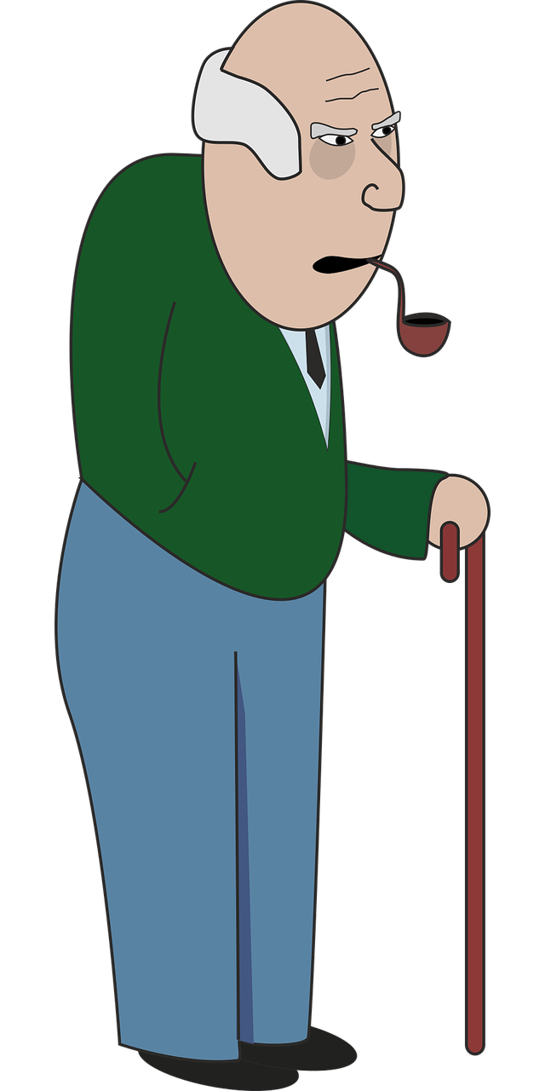
Challenges in translation of speech
Audio challenges
Text-Speech mismatch
Disfluencies
Hesitations: “uh”, “uhm”, “hmm”,
Discourse markers: “you know”, “I mean”,…
Repetitions: “It had, it had been a good day”
Corrections: “no, it cannot, I cannot go there”
No punctuation
Let’s eat Grandpa !
Let’s eat, Grandpa !

Slide 22
Challenges in translation of speech
Audio challenges
Text-Speech mismatch
Error propagation
ASR errors worse after translation
More difficult to compensate by human
MT adds additional errors
Reden (engl. speeches)
Reben (engl. vines)

Slide 23
Challenges in translation of speech
Audio challenges
Text-Speech mismatch
Error propagation
Data
End-to-End data:
Growing amount but still limited
Integration of other data types
Speech transcripts
Parallel data

Slide 24
Challenges in translation of speech
Audio challenges
Text-Speech mismatch
Error propagation
Data
Partial information
Online: Translate during production of speech
Generate translation before full sentence is known

Slide 25
Sec 1.3
Traditional cascade approach

Slide 26
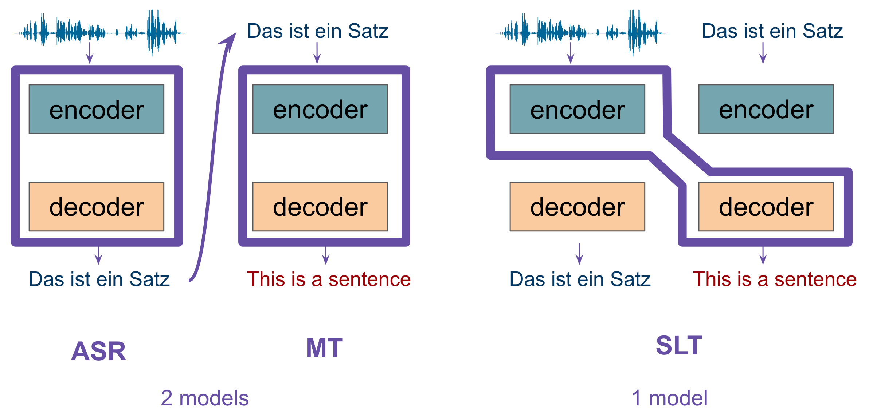
Traditional cascade approach

Slide 27
Traditional cascade approach
Modular, pipeline approach
ASR, MT: isolated objectives
acoustic model
phrase table
LM
LM
(Waibel et al. 1991; Vidal, 1997; Ney, 1999; Saleem et al. 2004; Matusov et al. 2005; Bertoldi and Federico, 2005; Quan et al. 2005; Kumar et al. 2014; IWSLT Eval Campaigns 2004—)

Slide 28
Data Used
Datasets with parallel speech + translations arose with E2E models
Traditionally, cascades used separate datasets for their component models
IWSLT Evaluation Campaigns (2004-present): ASR, MT, ST tasks
⊕ many more data sources
⊖ data is from different domains

Slide 29
Modular Models
Domain challenge: mismatch between ASR output and MT input
ASR output:
lowercase, punctuation removed
disfluencies (um, uh, …, repetitions, false starts)
ASR errors
⟶ Differing training data domains, train-test mismatch: requires adaptation!

Slide 30
Modular Models
Das ist ein Satz
ASR
MT
Das ist ein Satz
This is a sentence
2 models

Slide 31
Modular Models
Das ist ein Satz.
ASR
MT
das uh ist ein satz
This is a sentence.
2 models

Slide 32
Modular Models
Das ist ein Satz.
ASR
MT
das uh ist ein satz
This is a sentence.

Slide 33
Modular Models
Das ist ein Satz.
ASR
MT
disfluency removal
das ist ein satz
This is a sentence.
(Wang et al. 2010; Cho et al. 2013/2014)

Slide 34
Modular Models
Das ist ein Satz.
ASR
MT
disfluency removal
recase & repunctuate
Das ist ein Satz.
This is a sentence.
(Cho et al. 2012; Cho et al. 2017)

Slide 35
Modular Models
Das ist ein Satz.
ASR
MT
disfluency removal
recase & repunctuate
Das ist ein Satz.
This is a sentence.

Slide 36
Modular Models
adapted data
Das ist ein Satz.
das is ein satz
ASR
MT
disfluency removal
recase & repunctuate
Das ist ein Satz.
This is a sentence.
(Tsvetkov et al. 2014; Ruiz et al. 2015; Sperber et al. 2017)

Slide 37
Modular Models
adapted data
Das ist ein Satz.
das is ein satz
ASR
MT
disfluency removal
recase & repunctuate
Das ist ein Satz.
This is a sentence.
lattice output
(Post et al. 2013; Kumar et al. 2014; Sperber et al. 2017)

Slide 38
Modular Models
adapted data
Das ist ein Satz.
das is ein satz
ASR
MT
disfluency removal
recase & repunctuate
Das ist ein Satz.
This is a sentence.
Several modules, each with an isolated task
Designed to remove errors, can still propagate
lattice output

Slide 39
Sec 2:
End-to-End
Current state
Input representations
Architecture modifications
Output representations

Slide 40
Sec 2.1
Current state

Slide 41
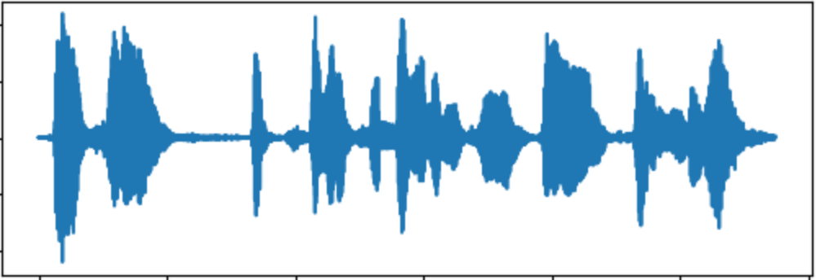
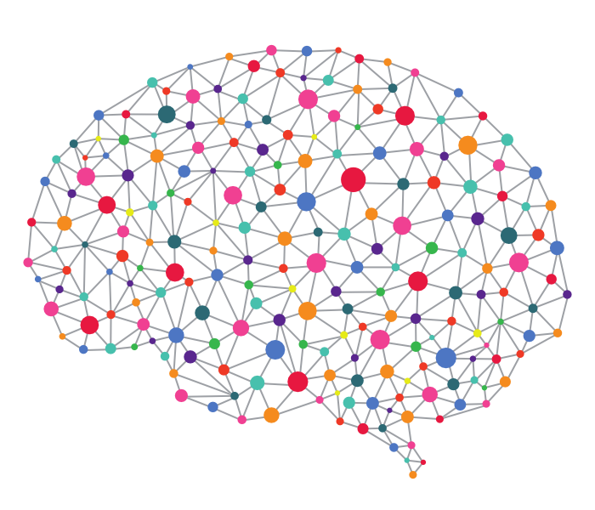
End-to-end SLT (Bérard et al., 2016; Weiss et al., 2017)
What a wonderful tutorial!

Slide 42
Definition of end-to-end approach
End-to-end model:
No intermediate discrete representations (transcripts like in cascade or multiple hypotheses like in rover technique)
All parameters/parts that are used during decoding need to be trained on the end2end task (may also be trained on other tasks → multitasking ok, LM rescoring is not ok)
Other definitions are possible depending on the application
IWSLT 2020 (Ansari et al., 2020)

Slide 43
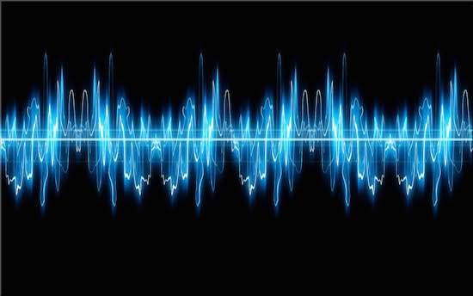
end-to-end speech translation (e2e)
Spanish Audio
English Translated text
-
-
-
What a wonderful tutorial!
0.71
0.34
0.12
0.51
0.05
0.74
Input text
encoder
decoder
Notes:
trained independently and combined in a log-linear scheme in which each model is assigned a different weight by a tuning algorithm.

Slide 44
end-to-end speech translation (e2e)
Notes:
trained independently and combined in a log-linear scheme in which each model is assigned a different weight by a tuning algorithm.

Slide 45
end-to-end speech translation (e2e)
Audio Representation
Notes:
trained independently and combined in a log-linear scheme in which each model is assigned a different weight by a tuning algorithm.

Slide 46
end-to-end speech translation (e2e)
encoder
decoder
decoder
Notes:
trained independently and combined in a log-linear scheme in which each model is assigned a different weight by a tuning algorithm.

Slide 47
end-to-end speech translation (e2e)
0.71
0.34
0.12
0.51
0.05
0.74
0.01
0.56
0.67
0.98
0.34
0.93
0.13
encoder
decoder
decoder
Notes:
trained independently and combined in a log-linear scheme in which each model is assigned a different weight by a tuning algorithm.

Slide 48
end-to-end speech translation (e2e)
0.71
0.34
0.12
0.51
0.05
0.74
0.01
0.56
0.67
0.98
0.34
0.93
0.13
encoder
decoder
decoder
Notes:
trained independently and combined in a log-linear scheme in which each model is assigned a different weight by a tuning algorithm.

Slide 49
end-to-end speech translation (e2e)
0.71
0.34
0.12
0.51
0.05
0.74
0.01
0.56
0.67
0.98
0.34
0.93
0.13
encoder
decoder
decoder
System Architectures
Notes:
trained independently and combined in a log-linear scheme in which each model is assigned a different weight by a tuning algorithm.

Slide 50
end-to-end speech translation (e2e)
0.71
0.34
0.12
0.51
0.05
0.74
0.01
0.56
0.67
0.98
0.34
0.93
0.13
encoder
decoder
W h a t <space> a <space> w o n d e r f u l <space> t u t o r i a l !
Notes:
trained independently and combined in a log-linear scheme in which each model is assigned a different weight by a tuning algorithm.

Slide 51
end-to-end speech translation (e2e)
0.71
0.34
0.12
0.51
0.05
0.74
0.01
0.56
0.67
0.98
0.34
0.93
0.13
encoder
decoder
Wh @at a w @on @der @fu @l tut @or @ial!
Notes:
trained independently and combined in a log-linear scheme in which each model is assigned a different weight by a tuning algorithm.

Slide 52
end-to-end speech translation (e2e)
0.71
0.34
0.12
0.51
0.05
0.74
0.01
0.56
0.67
0.98
0.34
0.93
0.13
encoder
decoder
What a wonderful tutorial!
Notes:
trained independently and combined in a log-linear scheme in which each model is assigned a different weight by a tuning algorithm.

Slide 53
end-to-end speech translation (e2e)
0.71
0.34
0.12
0.51
0.05
0.74
0.01
0.56
0.67
0.98
0.34
0.93
0.13
encoder
decoder
What a wonderful tutorial!
Output Representation
Notes:
trained independently and combined in a log-linear scheme in which each model is assigned a different weight by a tuning algorithm.

Slide 54
Sequence-to-Sequence Model
-
-
-
0.71
0.34
0.12
0.51
0.05
0.74
encoder
decoder
Pros:
Direct access to the audio during translation
No error propagation
One system to maintain
Notes:
trained independently and combined in a log-linear scheme in which each model is assigned a different weight by a tuning algorithm.

Slide 55
Sequence-to-Sequence Model
-
-
-
0.71
0.34
0.12
0.51
0.05
0.74
encoder
decoder
Pros:
Direct access to the audio during translation
No error propagation
One system to maintain
Cons:
Less consolidated technology
Scarcity of training data
Non-monotonic alignments audio-text
Notes:
trained independently and combined in a log-linear scheme in which each model is assigned a different weight by a tuning algorithm.

Slide 56
Cascade vs End-to-End Systems
Cascade
End-to-End
Large corpora for ASR and MT
Less complex tasks
Error propagation
Information loss
Higher latency
Access to all audio information
Reduced latency
Easier management
Small corpora
More complex task

Slide 57
Cascade vs End-to-End Systems
Cascade
End-to-End
IWSLT Evaluation Campaign (Niehues et al., 2018, Niehues et al., 2019, Ansari et al., 2020)
2018

Slide 58
Cascade vs End-to-End Systems
Cascade
Cascade
End-to-End
End-to-End
IWSLT Evaluation Campaign (Niehues et al., 2018, Niehues et al., 2019, Ansari et al., 2020)
2018
2019

Slide 59
Cascade vs End-to-End Systems
Cascade
Cascade
Cascade
End-to-End
End-to-End
End-to-End
IWSLT Evaluation Campaign (Niehues et al., 2018, Niehues et al., 2019, Ansari et al., 2020)
2018
2019
2020

Slide 60
Cascade vs End-to-End Systems
Most of the papers (Weiss et al., 2017, Jia et al., 2019, Di Gangi et al., 2019) about end-to-end SLT system mention the following advantages over the cascade:
No error propagation:
End-to-end naturally avoids compounding errors between the ASR and MT systems.
Direct access to the audio:
End-to-end better manipulates paralinguistic and non-linguistic information during translation, e.g. maintaining the source speaker’s voice, emotion, and prosody, in the synthesized translated speech.

Slide 61
Cascade vs End-to-End Systems
Most of the papers (Weiss et al., 2017, Jia et al., 2019, Di Gangi et al., 2019) about end-to-end SLT system mention the following advantages over the cascade:
No error propagation:
End-to-end naturally avoids compounding errors between the ASR and MT systems
Direct access to the audio:
End-to-end better manipulates paralinguistic and non-linguistic information during translation
The correctness of these statements taken for granted

Slide 62
Cascade vs End-to-End Systems
Key questions:
No answers in this tutorial!
Is it true that end-to-end avoids error propagation?
To what extent does accessing the audio help? How? When?

Slide 63
Cascade vs End-to-End Systems
Key questions:
No answers in this tutorial!
Is it true that end-to-end avoids error propagation?
To what extent does accessing the audio help? How? When?

Slide 64
No error propagation
Open issues:
Overall translation quality is not enough to measure the reduction of error prop.
For a direct comparison of the Cascade and e2e, the intermediate representations cannot be used (transcript vs. null)
Difficult to disentangle the impact of various components in e2e (two tasks collapsed into one)
Not a consolidated architecture in end-to-end technology
Possible opening:
Sperber et al., (2019) consider the encoder output as an intermediate representation and pose the attention on the presence of errors in it

Slide 65
No error propagation
Open issues:
Overall translation quality is not enough to measure the reduction of error prop.
For a direct comparison of the Cascade and e2e, the intermediate representations cannot be used (transcript vs. null)
Difficult to disentangle the impact of various components in e2e (two tasks collapsed into one)
Not a consolidated architecture in end-to-end technology
Possible opening:
Sperber et al., (2019) consider the encoder output as an intermediate representation and pose the attention on the presence of errors in it

Slide 66
No error propagation
Open issues:
Overall translation quality is not enough to measure the reduction of error prop.
For a direct comparison of the Cascade and e2e, the intermediate representations cannot be used (transcript vs. null)
Difficult to disentangle the impact of various components in e2e (two tasks collapsed into one)
Not a consolidated architecture in end-to-end technology
Possible opening:
Sperber et al., (2019) consider the encoder output as an intermediate representation and pose the attention on the presence of errors in it

Slide 67
No error propagation
Open issues:
Overall translation quality is not enough to measure the reduction of error prop.
For a direct comparison of the Cascade and e2e, the intermediate representations cannot be used (transcript vs. null)
Difficult to disentangle the impact of various components in e2e (two tasks collapsed into one)
Not a consolidated architecture in end-to-end technology
Possible opening:
Sperber et al., (2019) consider the encoder output as an intermediate representation and pose the attention on the presence of errors in it

Slide 68
No error propagation
Open issues:
Overall translation quality is not enough to measure the reduction of error prop.
For a direct comparison of the Cascade and e2e, the intermediate representations cannot be used (transcript vs. null)
Difficult to disentangle the impact of various components in e2e (two tasks collapsed into one)
Not a consolidated architecture in end-to-end technology
Possible opening:
Sperber et al., (2019) consider the encoder output as an intermediate representation and pose the attention on the presence of errors in it

Slide 69
Direct access to the audio
Open issues:
Better encoder technology results in better translation performance (not enough)
Not clear what aspects of the audio can help (e.g. prosody, emotions, tone, pauses)
Audio understanding capability can only be analyzed in the final translation (no transcripts)
Lack of ad hoc test sets to measure the impact of prosody, emotions, ...
Extrinsic evaluations (e.g. male/female audio recognition) should not ignore the translation aspects of the problem
Possible openings:
Karakanta et al. (2020): the direct access to the audio pauses improves subtitles’ quality
Gaido et al. (2020): vocal characteristics can guide e2e systems in modeling gender (but opens ethical issues!)

Slide 70
Direct access to the audio
Open issues:
Better encoder technology results in better translation performance (not enough)
Not clear what aspects of the audio can help (e.g. prosody, emotions, tone, pauses)
Audio understanding capability can only be analyzed in the final translation (no transcripts)
Lack of ad hoc test sets to measure the impact of prosody, emotions, ...
Extrinsic evaluations (e.g. male/female audio recognition) should not ignore the translation aspects of the problem
Possible openings:
Karakanta et al. (2020): the direct access to the audio pauses improves subtitles’ quality
Gaido et al. (2020): vocal characteristics can guide e2e systems in modeling gender (but opens ethical issues!)

Slide 71
Direct access to the audio
Open issues:
Better encoder technology results in better translation performance (not enough)
Not clear what aspects of the audio can help (e.g. prosody, emotions, tone, pauses)
Audio understanding capability can only be analyzed in the final translation (no transcripts)
Lack of ad hoc test sets to measure the impact of prosody, emotions, ...
Extrinsic evaluations (e.g. male/female audio recognition) should not ignore the translation aspects of the problem
Possible openings:
Karakanta et al. (2020): the direct access to the audio pauses improves subtitles’ quality
Gaido et al. (2020): vocal characteristics can guide e2e systems in modeling gender (but opens ethical issues!)

Slide 72
Direct access to the audio
Open issues:
Better encoder technology results in better translation performance (not enough)
Not clear what aspects of the audio can help (e.g. prosody, emotions, tone, pauses)
Audio understanding capability can only be analyzed in the final translation (no transcripts)
Lack of ad hoc test sets to measure the impact of prosody, emotions, ...
Extrinsic evaluations (e.g. male/female audio recognition) should not ignore the translation aspects of the problem
Possible openings:
Karakanta et al. (2020): the direct access to the audio pauses improves subtitles’ quality
Gaido et al. (2020): vocal characteristics can guide e2e systems in modeling gender (but opens ethical issues!)

Slide 73
Direct access to the audio
Open issues:
Better encoder technology results in better translation performance (not enough)
Not clear what aspects of the audio can help (e.g. prosody, emotions, tone, pauses)
Audio understanding capability can only be analyzed in the final translation (no transcripts)
Lack of ad hoc test sets to measure the impact of prosody, emotions, ...
Possible openings:
Karakanta et al. (2020): the direct access to the audio pauses improves subtitles’ quality
Gaido et al. (2020): vocal characteristics can guide e2e systems in modeling gender (but opens ethical issues!)

Slide 74
Sec 2.2
Input representations

Slide 75
From text translation to speech translation
Encoder-decoder models:
Can apply similar techniques
Main differences to text translation
Input: Audio signal
Continuous
Longer
encoder
decoder

Slide 76
Audio representation
Following best-practice from ASR
Sampling
Measure Amplitude of signal at time t
Typically 16 kHz
decoder

Slide 77
Audio representation
Following best-practice from ASR
Sampling
Measure Amplitude of signal at time t
Typically 16 kHz
Windowing
Split signal in different windows
Length: ~ 20-30 ms
Shift: ~ 10 ms
Result:
One representation every 10 ms
decoder

Slide 78
Audio representation
Input features:
Signal processing:
Most common:
Mel-Frequency Cepstral Coefficients (MFCC)
Log mel-filterbank features (FBANK)
Idea:
Analyse frequencies of the signal
Steps:
Discrete Fourier Transformation
Mel filter-banks
Log scale
(Inverse Discrete Fourier Transformation)
Size:
20-100 features per frame

Slide 79
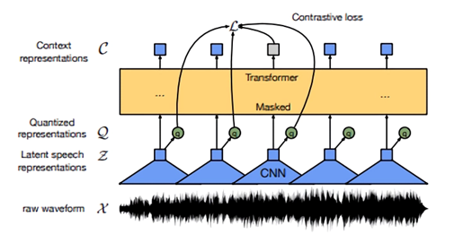
Audio representation
Input features:
Signal processing:
Deep Learning:
Self-supervised Learning
Predict frame based on context
E.g. Wav2Vec 2.0 (Baevski et al., 2020)
Baevski et al. 2020

Slide 80
Challenges
Variation
Many different ways to speech same sentence
Data augmentation
Sequence Length
IWSLT test set 2020
Segments: 1804
Words: 32.795
Characters: 149.053
Features: 1.471.035
Architectural changes
A U D I O
audio

Slide 81
Data augmentation
Limited training data
Generate synthetic training data
ASR investigated several possibilities
Noise injection (Hannun et al., 2014)
Speed perturbation (Ko et al., 2015)
Successful technique in deep learning ASR
SpecAugment (Spark et al., 2019)
Also applied in ST (Bahar et al, 2019)

Slide 82
SpecAugment
Directly applied on audio features
Idea:
Mask information

Slide 83
SpecAugment
Directly applied on audio features
Idea:
Mask information
Time masking
Set several consecutive feature vector to zero

Slide 84
SpecAugment
Directly applied on audio features
Idea:
Mask information
Time masking
Set several consecutive feature vector to zero
Frequency masking
Mask consecutive frequency channels

Slide 85
Sec 2.3
Architecture & Modifications

Slide 86
End-to-End Architecture
Cascade
End-to-End

Slide 87
End-to-End Architecture
LSTM or Transformer Encoder-Decoder Models
However, speech ≠ text
End-to-End

Slide 88
Speech vs. Text
Speech features ~8-10x longer than the equivalent character sequences
c h a r a c t e r s
Discretized audio –– speech frames
SPEECH:
p
…
TEXT:
p
p
frames
o
…
frames
Each feature vector is unique, Number of feature vectors per phone varies

Slide 89
Challenges
Sequence length:
increased memory requirements
greater distance between dependencies
Redundancy:
adds task for model to learn
Variation:
requires more data for model to learn correspondences

Slide 90
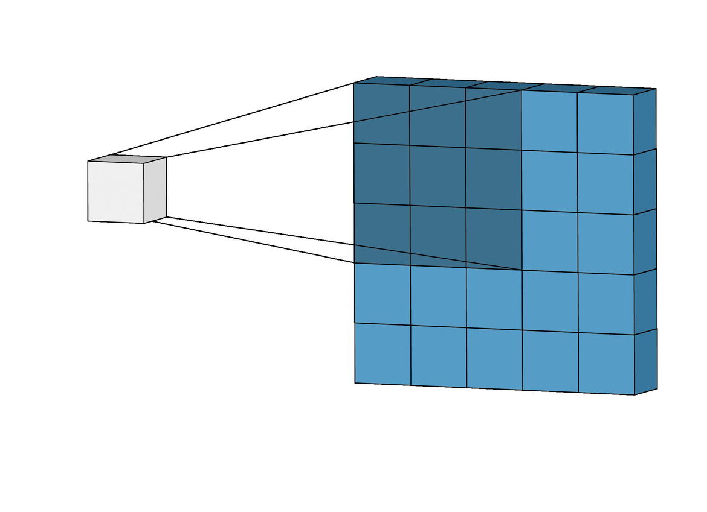
Dimensionality Reduction
Two directions: ① temporal and ② feature dimension
Convolutional layers enable fixed-length downsampling
f+Δ+ΔΔ
80’
80’
Conv1D, ConvLSTM layers
80’
40’
Scale sequence length and feature dimension linearly by a factor corresponding to the convolutional kernel size and stride length
(Weiss et al. 2017; Bansal et al. 2018)
Notes:
Convolutional layers scale the sequence length linearly by a factor corresponding to the convolutional kernel size and stride length

Slide 91
Pyramidal Encoder
Motivation: do not need attention to the granularity of speech features
Reduce dimensionality through encoder
speech features
LSTM hidden states
2x
Linear projection, ASR: (Zhang et al. 2017; Sperber et al. 2018) Pyramidal encoder in ST:
(Weiss et al. 2017; Salesky et al. 2019; Sperber et al. 2019; Salesky et al. 2020)
concatenation
sum
skip
linear projection
2x
2x
8x temporal reduction
Listen, Attend, and Spell (Chan et al. 2015)

Slide 92
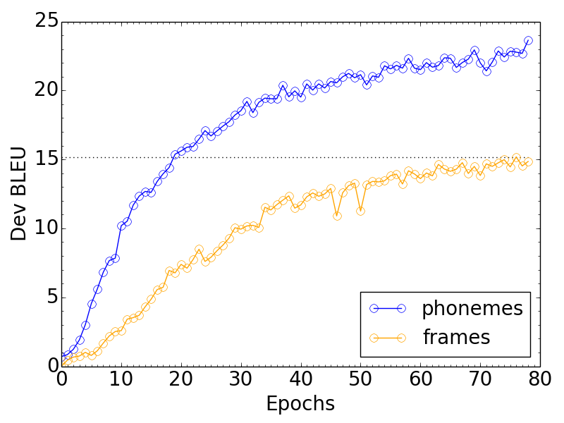
Dimensionality Reduction Impact
Improved training efficiency!
Reduces memory footprint
Faster convergence
Improved results
(Salesky et al. 2019)

Slide 93
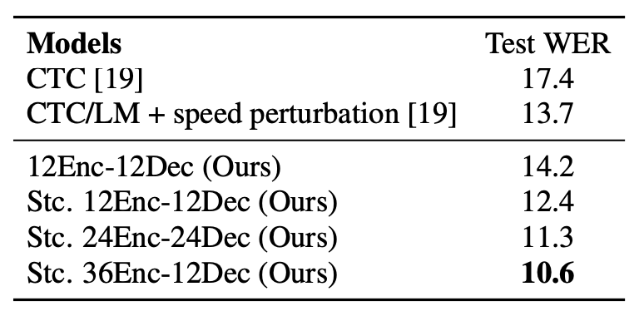
Encoder and Decoder Depth
MT: typically same depth for encoder and decoder
ST: empirically, deeper encoders than decoders perform better! ⟶ more parameters allocated to learning more complicated associations between inputs
(Zhang et al. 2017; Pham et al. 2018)

Slide 94
LSTM ⟶ Transformer
LSTM
Multiple Transformer Heads
Transformer-S
2D Convolutions
Distance penalty for attention
2D self-attention …
Conv-Transformer
FFN
↓
SA
output
output
(DiGangi et al. 2019; Huang et al. 2020)

Slide 95
Sec 2.4
Output representations

Slide 96
Output representation
0.71
0.34
0.12
0.51
0.05
0.74
0.01
0.56
0.67
0.98
0.34
0.93
0.13
decoder

Slide 97
Output representation
0.71
0.34
0.12
0.51
0.05
0.74
0.01
0.56
0.67
0.98
0.34
0.93
0.13
decoder

Slide 98
Output representation
0.71
0.34
0.12
0.51
0.05
0.74
0.01
0.56
0.67
0.98
0.34
0.93
0.13
decoder

Slide 99
Output representation
0.71
0.34
0.12
0.51
0.05
0.74
0.01
0.56
0.67
0.98
0.34
0.93
0.13
decoder

Slide 100
Output representation
0.71
0.34
0.12
0.51
0.05
0.74
0.01
0.56
0.67
0.98
0.34
0.93
0.13
decoder

Slide 101
Output representation
0.71
0.34
0.12
0.51
0.05
0.74
0.01
0.56
0.67
0.98
0.34
0.93
0.13
decoder
What a wonderful tutorial!

Slide 102
Output representation
Word (Bansal et al., 2018)
Byte Pair Encoding (BPE) (Sperber et al., 2018)
Character (Bérard et al., 2016; Weiss et al., 2017)

Slide 103
Output representation: Word
Words as atomic unit
Applicable only for small and high-repetitive datasets
Tested in low-resource speech-to-text translation
decoder

Slide 104
Output representation: Word
Words as atomic unit
Applicable only for small and high-repetitive datasets
Tested in low-resource speech-to-text translation
decoder
What
a
...

Slide 105
Output representation: BPE
Introduced in Neural Machine Translation to fit a large vocabulary in memory
Each target sentence splits in sub-word units
Iterative approach merging the most frequently co-occurring characters or character sequences
Widely used in several NLP tasks

Slide 106
Output representation: BPE
Training and test data are split based on a learned vocabulary
After translation, BPEs converted into words
decoder

Slide 107
Output representation: BPE
Training and test data are split based on a learned vocabulary
After translation, BPEs converted into words
decoder
Wh
@at
a
w
@on
@der

Slide 108
Output representation: Characters
Each sentence splits in characters with a special symbol for the empty space
Training and test data are split
After translation, characters converted into words
decoder

Slide 109
Output representation: Characters
Each sentence splits in characters with a special symbol for the empty space
Training and test data are split
After translation, characters converted into words
decoder
W
h
a
t
<space>
a

Slide 110
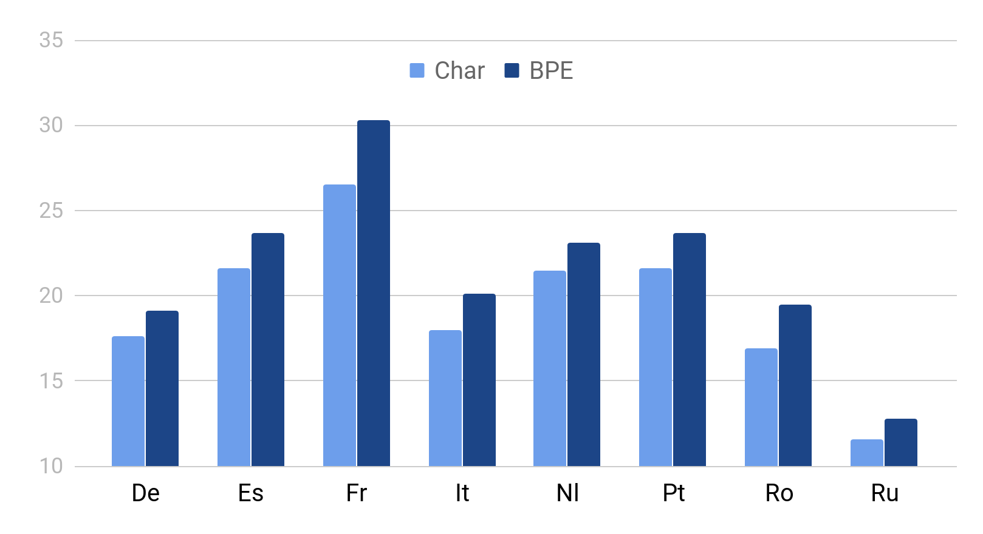
Translation performance (Di Gangi et al., 2020)
BLEU
BPE outperforms Characters in all languages

Slide 111
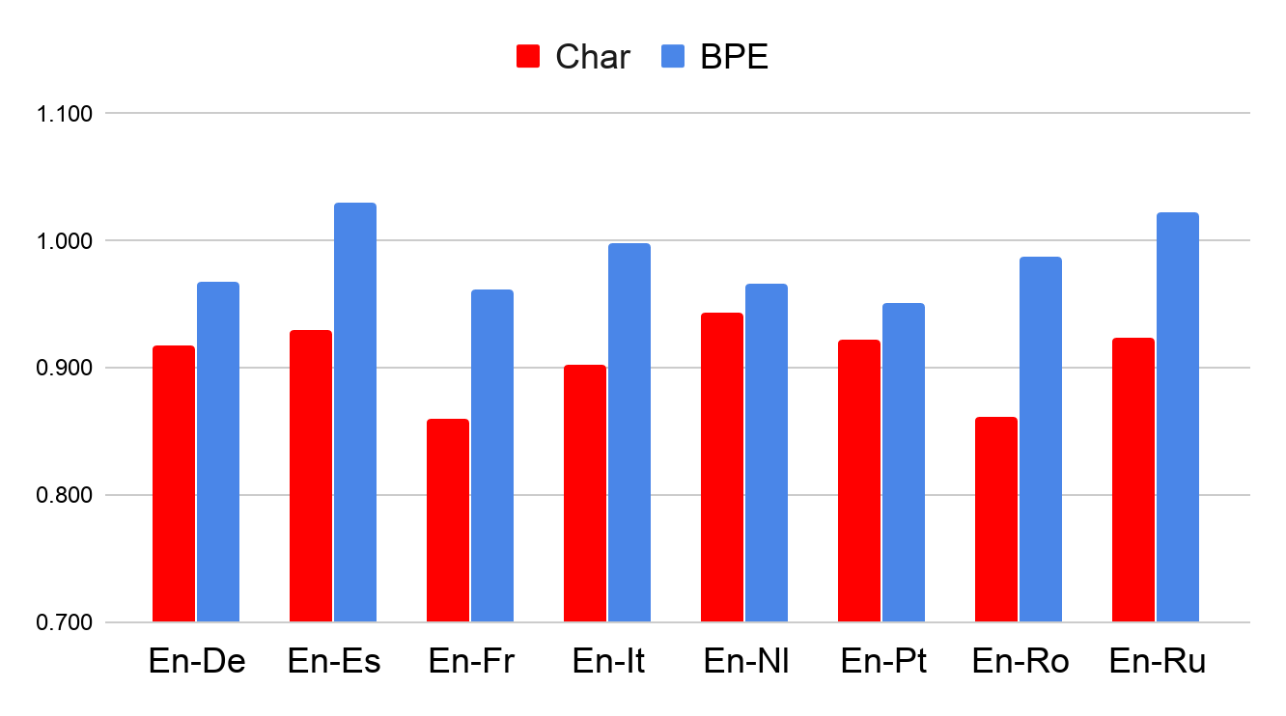
Length comparison
#Ref / #SLT
BPE produces longer sentences

Slide 112
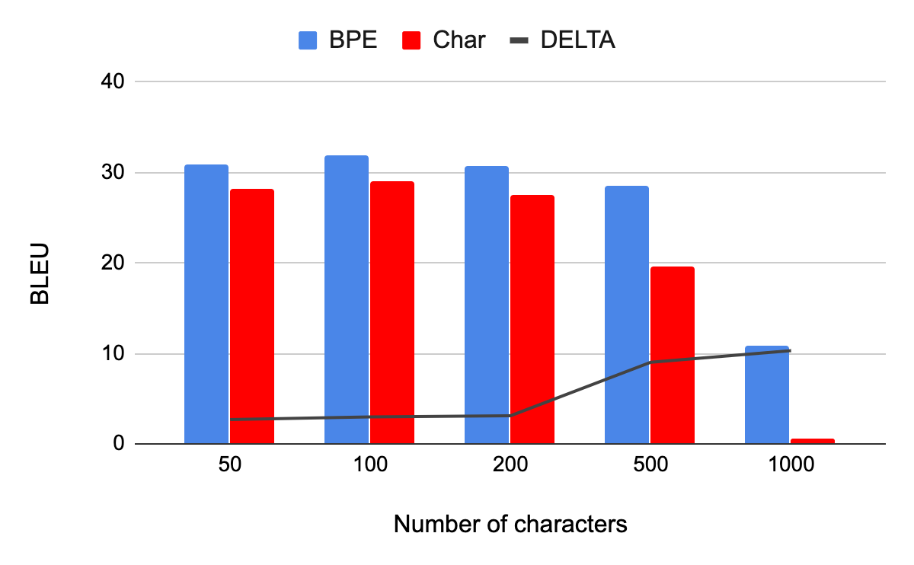
Translation quality by sent. length
En - Fr
BPE better on longer sentences

Slide 113
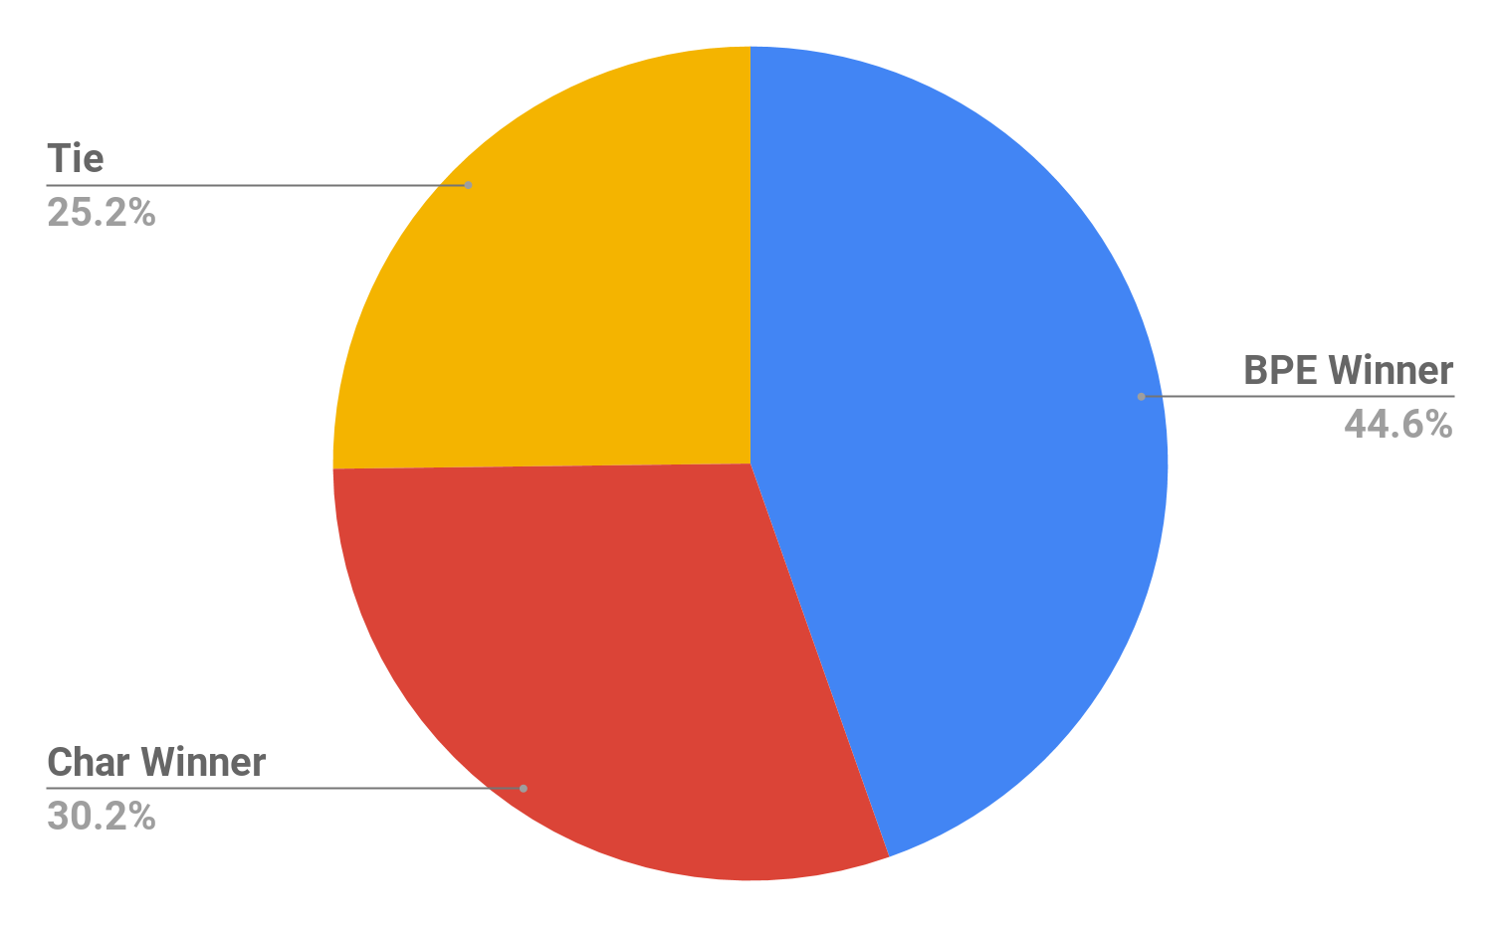
Sentence Level Comparison
Chars better on lower quality translations

Slide 114
Sec 3:
Leveraging Data Sources
Available data
Techniques
Multi-task learning
Transfer learning and pretraining Knowledge distillation
Alternate data representations

Slide 115
Sec 3.1
Available Data

Slide 116
Available data
ASR
MT
ST
(text, translation)
(audio, transcript)
(audio, transcript, translation)
Notes:
Lots of PARALLEL data for MT and ASR
Few resources featuring (audio, transcript, translation) alignment

Slide 117
Available data
Question: Why so few data?
Answer: High creation costs!
Find good data (e.g. audio+transcr+transl., free)
Download and clean
Segment transcripts and translations
Align transcripts and translations
Align transcripts and audio
Filter wrong/poor alignments
Pack in suitable format, extract features
ASR
MT
MuST-C (Cattoni et al., 2021)
ST
(audio, transcript, translation)
(text, translation)
(audio, transcript)
(audio, transcript, translation)
Notes:
Why? Collecting them is costly!

Slide 118
Available data (≥ 20 hrs of speech)
(no name) | (Tohyama et al., 2005) | En↔Jp 182hrs | simult. interpret.
(no name) | (Paulik and Waibel, 2009) | En→Es 111 Es→En 105hrs | simult. interpret.
Fisher | (Post 2013) | Es→En 160hrs | phone conversations
STC | (Shimizu et al., 2014) | En↔Jp 22hrs | simult. interpret.
How2 | (Sanabria et al., 2018) | En→Pt 300hrs | instructional videos
IWSLT 2018 | (Niehues et al., 2018) | En→De 273hrs | TED talks
LIBRI-TRANS | (Kocabiyikoglu et al., 2018) | En→Fr 236hrs | read audiobooks
MuST-C | (Cattoni et al., 2021) | En→ 14 lang. (237-504hrs) | TED talks
CoVoST | (Wang et al., 2020) | En→15 lang. (929hrs), 21 lang.→En (30-311hrs) | read, Common Voice
Europarl-ST | (Iranzo-Sanchez et al., 2020) | 9 lang. (72 dir., 10-90hrs) | EP proceedings
LibriVoxDeEn | (Beilharz et al., 2020) | De→En 100hrs | read audiobooks
MaSS | (Zanon Boito et a., 2020) | 8 lang. (56 dir.) 20hrs | Bible readings
BSTC | (Baidu, 2020) | Zh→En 50hrs | simult. interpret.
Multilingual TEDx | (Salesky et al., 2021) | 8 lang.→6 lang. 11-69hrs | TED talks
Notes:
Quite complete list

Slide 119
Available data (≥ 20 hrs of speech)
(no name) | (Tohyama et al., 2005) | En↔Jp 182hrs | simult. interpret.
(no name) | (Paulik and Waibel, 2009) | En→Es 111 Es→En 105hrs | simult. interpret.
Fisher | (Post 2013) | Es→En 160hrs | phone conversations
STC | (Shimizu et al., 2014) | En↔Jp 22hrs | simult. interpret.
How2 | (Sanabria et al., 2018) | En→Pt 300hrs | instructional videos
IWSLT 2018 | (Niehues et al., 2018) | En→De 273hrs | TED talks
LIBRI-TRANS | (Kocabiyikoglu et al., 2018) | En→Fr 236hrs | read audiobooks
MuST-C | (Cattoni et al., 2021) | En→ 14 lang. (237-504hrs) | TED talks
CoVoST | (Wang et al., 2020) | En→15 lang. (929hrs), 21 lang.→En (30-311hrs) | read, Common Voice
Europarl-ST | (Iranzo-Sanchez et al., 2020) | 9 lang. (72 dir., 10-90hrs) | EP proceedings
LibriVoxDeEn | (Beilharz et al., 2020) | De→En 100hrs | read audiobooks
MaSS | (Zanon Boito et a., 2020) | 8 lang. (56 dir.) 20hrs | Bible readings
BSTC | (Baidu, 2020) | Zh→En 50hrs | simult. interpret.
Multilingual TEDx | (Salesky et al., 2021) | 8 lang.→6 lang. 11-69hrs | TED talks
Half of these corpora were built in the last 2 years
Notes:
numbers are growing but still low

Slide 120
Available data (≥ 20 hrs of speech)
(no name) | (Tohyama et al., 2005) | En↔Jp 182hrs | simult. interpret.
(no name) | (Paulik and Waibel, 2009) | En→Es 111 Es→En 105hrs | simult. interpret.
Fisher | (Post 2013) | Es→En 160hrs | phone conversations
STC | (Shimizu et al., 2014) | En↔Jp 22hrs | simult. interpret.
How2 | (Sanabria et al., 2018) | En→Pt 300hrs | instructional videos
IWSLT 2018 | (Niehues et al., 2018) | En→De 273hrs | TED talks
LIBRI-TRANS | (Kocabiyikoglu et al., 2018) | En→Fr 236hrs | read audiobooks
MuST-C | (Cattoni et al., 2021) | En→ 14 lang. (237-504hrs) | TED talks
CoVoST | (Wang et al., 2020) | En→15 lang. (929hrs), 21 lang.→En (30-311hrs) | read, Common Voice
Europarl-ST | (Iranzo-Sanchez et al., 2020) | 9 lang. (72 dir., 10-90hrs) | EP proceedings
LibriVoxDeEn | (Beilharz et al., 2020) | De→En 100hrs | read audiobooks
MaSS | (Zanon Boito et a., 2020) | 8 lang. (56 dir.) 20hrs | Bible readings
BSTC | (Baidu, 2020) | Zh→En 50hrs | simult. interpret.
Multilingual TEDx | (Salesky et al., 2021) | 8 lang.→6 lang. 11-69hrs | TED talks
Trend (1): increasing data size (>200 hours of translated speech)
Notes:
Size is increasing: important to train data-hungry neural models

Slide 121
Available data (≥ 20 hrs of speech)
(no name) | (Tohyama et al., 2005) | En↔Jp 182hrs | simult. interpret.
(no name) | (Paulik and Waibel, 2009) | En→Es 111 Es→En 105hrs | simult. interpret.
Fisher | (Post 2013) | Es→En 160hrs | phone conversations
STC | (Shimizu et al., 2014) | En↔Jp 22hrs | simult. interpret.
How2 | (Sanabria et al., 2018) | En→Pt 300hrs | instructional videos
IWSLT 2018 | (Niehues et al., 2018) | En→De 273hrs | TED talks
LIBRI-TRANS | (Kocabiyikoglu et al., 2018) | En→Fr 236hrs | read audiobooks
MuST-C | (Cattoni et al., 2021) | En→ 14 lang. (237-504hrs) | TED talks
CoVoST | (Wang et al., 2020) | En→15 lang. (929hrs), 21 lang.→En (30-311hrs) | read, Common Voice
Europarl-ST | (Iranzo-Sanchez et al., 2020) | 9 lang. (72 dir., 10-90hrs) | EP proceedings
LibriVoxDeEn | (Beilharz et al., 2020) | De→En 100hrs | read audiobooks
MaSS | (Zanon Boito et a., 2020) | 8 lang. (56 dir.) 20hrs | Bible readings
BSTC | (Baidu, 2020) | Zh→En 50hrs | simult. interpret.
Multilingual TEDx | (Salesky et al., 2021) | 8 lang.→6 lang. 11-69hrs | TED talks
Trend (2): more language directions
Notes:
More languages: important to check portability of the approaches and serve more application scenarios

Slide 122
Available data (≥ 20 hrs of speech)
(no name) | (Tohyama et al., 2005) | En↔Jp 182hrs | simult. interpret.
(no name) | (Paulik and Waibel, 2009) | En→Es 111 Es→En 105hrs | simult. interpret.
Fisher | (Post 2013) | Es→En 160hrs | phone conversations
STC | (Shimizu et al., 2014) | En↔Jp 22hrs | simult. interpret.
How2 | (Sanabria et al., 2018) | En→Pt 300hrs | instructional videos
IWSLT 2018 | (Niehues et al., 2018) | En→De 273hrs | TED talks
LIBRI-TRANS | (Kocabiyikoglu et al., 2018) | En→Fr 236hrs | read audiobooks
MuST-C | (Cattoni et al., 2021) | En→ 14 lang. (237-504hrs) | TED talks
CoVoST | (Wang et al., 2020) | En→15 lang. (929hrs), 21 lang.→En (30-311hrs) | read, Common Voice
Europarl-ST | (Iranzo-Sanchez et al., 2020) | 9 lang. (72 dir., 10-90hrs) | EP proceedings
LibriVoxDeEn | (Beilharz et al., 2020) | De→En 100hrs | read audiobooks
MaSS | (Zanon Boito et a., 2020) | 8 lang. (56 dir.) 20hrs | Bible readings
BSTC | (Baidu, 2020) | Zh→En 50hrs | simult. interpret.
Multilingual TEDx | (Salesky et al., 2021) | 8 lang.→6 lang. 11-69hrs | TED talks
Trend (3): multilinguality + non-English speech
Notes:
Non-English speech: again portability of the approaches, and testing on less resourced languages

Slide 123
Available data (≥ 20 hrs of speech)
(no name) | (Tohyama et al., 2005) | En↔Jp 182hrs | simult. interpret.
(no name) | (Paulik and Waibel, 2009) | En→Es 111 Es→En 105hrs | simult. interpret.
Fisher | (Post 2013) | Es→En 160hrs | phone conversations
STC | (Shimizu et al., 2014) | En↔Jp 22hrs | simult. interpret.
How2 | (Sanabria et al., 2018) | En→Pt 300hrs | instructional videos
IWSLT 2018 | (Niehues et al., 2018) | En→De 273hrs | TED talks
LIBRI-TRANS | (Kocabiyikoglu et al., 2018) | En→Fr 236hrs | read audiobooks
MuST-C | (Cattoni et al., 2021) | En→ 14 lang. (237-504hrs) | TED talks
CoVoST | (Wang et al., 2020) | En→15 lang. (929hrs), 21 lang.→En (30-311hrs) | read, Common Voice
Europarl-ST | (Iranzo-Sanchez et al., 2020) | 9 lang. (72 dir., 10-90hrs) | EP proceedings
LibriVoxDeEn | (Beilharz et al., 2020) | De→En 100hrs | read audiobooks
MaSS | (Zanon Boito et a., 2020) | 8 lang. (56 dir.) 20hrs | Bible readings
BSTC | (Baidu, 2020) | Zh→En 50hrs | simult. interpret.
Multilingual TEDx | (Salesky et al., 2021) | 8 lang.→6 lang. 11-69hrs | TED talks
Trend (4): same segmentation across datasets
Notes:
Same segmentation: important, in the training phase, for knowledge transfer with multilingual approaches

Slide 124
Available data (≥ 20 hrs of speech)
(no name) | (Tohyama et al., 2005) | En↔Jp 182hrs | simult. interpret.
(no name) | (Paulik and Waibel, 2009) | En→Es 111 Es→En 105hrs | simult. interpret.
Fisher | (Post 2013) | Es→En 160hrs | phone conversations
STC | (Shimizu et al., 2014) | En↔Jp 22hrs | simult. interpret.
How2 | (Sanabria et al., 2018) | En→Pt 300hrs | instructional videos
IWSLT 2018 | (Niehues et al., 2018) | En→De 273hrs | TED talks
LIBRI-TRANS | (Kocabiyikoglu et al., 2018) | En→Fr 236hrs | read audiobooks
MuST-C | (Cattoni et al., 2021) | En→ 14 lang. (237-504hrs) | TED talks
CoVoST | (Wang et al., 2020) | En→15 lang. (929hrs), 21 lang.→En (30-311hrs) | read, Common Voice
Europarl-ST | (Iranzo-Sanchez et al., 2020) | 9 lang. (72 dir., 10-90hrs) | EP proceedings
LibriVoxDeEn | (Beilharz et al., 2020) | De→En 100hrs | read audiobooks
MaSS | (Zanon Boito et a., 2020) | 8 lang. (56 dir.) 20hrs | Bible readings
BSTC | (Baidu, 2020) | Zh→En 50hrs | simult. interpret.
Multilingual TEDx | (Salesky et al., 2021) | 8 lang.→6 lang. 11-69hrs | TED talks
Trend (5): common test data across language pairs
Notes:
Common test data: important, in the test phase, for fair cross-language performance comparisons

Slide 125
Sec 3.2
Techniques

Slide 126
Recap: Available data
Can we make use of this large amount of data?
ASR
MT
ST
(text, translation)
(audio, transcript)
(audio, transcript, translation)

Slide 127
Multi-task learning
Definition:
“Multi-task learning improves generalization by leveraging the domain-specific information contained in the training signals of related tasks”
— Caruana, R. (1998)

Slide 128
Transfer Learning
Definition:
“Transfer learning and domain adaptation refer to the situation where what has been learned in one setting … is exploited to improve generalization in another setting”
— Page 526, Deep Learning, 2016.

Slide 129
Setting
ASR
MT
Text Decoder
Text Encoder
ST
Audio Encoder
Text Decoder

Slide 130
Setting
Multi-task
Train all three tasks jointly
ASR
MT
Text Decoder
Text Encoder
ST
Audio Encoder
Text Decoder

Slide 131
Setting
Multi-task
Pre-training
Train ASR and MT
Reuse part of the model for ST
ASR
MT
Text Decoder
Text Encoder
ST
Audio Encoder
Text Decoder

Slide 132
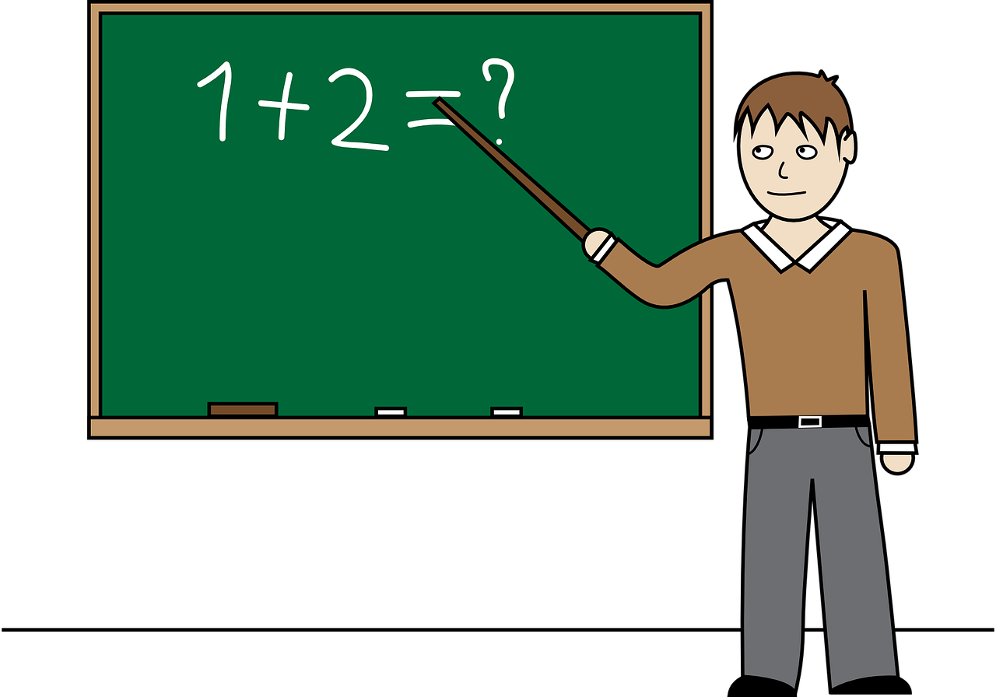
Setting
Multi-task
Pre-training
Knowledge distillation
Take MT model
Train ST based on training signal from MT
ASR
MT
Text Decoder
Text Encoder
ST
Audio Encoder
Text Decoder

Slide 133
Sec 3.2.1
Multi-task Learning

Slide 134
Multi-task learning
Baseline
No changes to the architecture
ST+ASR
One encoder
Source Language audio
Two decoder
Source Language text
Target language text
(Weis et al, 2017)
ASR
Text Decoder
ST
Audio Encoder
Text Decoder

Slide 135
Multi-task learning
Baseline
No changes to the architecture
ST+ASR
One encoder
Source Language audio
Two decoder
Source Language text
Target language text
(Weis et al, 2017)
ASR using CTC loss on encoder
(Hori et al, 2017)
(Bahra et al, 2019)
ASR
Source Text
ST
Audio Encoder
Text Decoder

Slide 136
Multi-task learning
Baseline
No changes to the architecture
ST+ASR
ST+ASR+MT
Two encoder
Source Language audio
Source Language text
Two decoder
Source Language text
Target language text
(Berard et al, 2018)
ASR
MT
Text Decoder
Text Encoder
ST
Audio Encoder
Text Decoder

Slide 137
Multi-task learning
Baseline
No changes to the architecture
ST+ASR
ST+ASR+MT
Inference:
Direct translation
No use of additional parts
ASR
MT
Text Decoder
Text Encoder
ST
Audio Encoder
Text Decoder

Slide 138
2-stage models
Make use of additional model also during decoding
Simplify task
using intermediate representation
Comparison to cascade:
Full pipeline is trained
Methods:
Adapt architecture
Preprocess data
ASR
MT
Text Decoder
Text Encoder
ST
Audio Encoder
Text Decoder

Slide 139
2-stage models
Cascade:
Target language decoder attents to source text decoder
(Anastasopoulos Chiang, 2018)
ASR
Text Decoder
ST
Audio Encoder
Text Decoder

Slide 140
2-stage models
Cascade:
Triangle:
Target language decoder attents to source audio encoder and source text decoder
(Anastasopoulos Chiang, 2018)
ASR
Text Decoder
ST
Audio Encoder
Text Decoder

Slide 141
2-stage models
Cascade:
Triangle:
Shared context vector
Target language decoder attents to source audio encoder and ASR context vectors
No direct influence of hard decisions of source text decoder
(Sperber et al, 2019)
ASR
Text Decoder
ST
Audio Encoder
Text Decoder

Slide 142
2-stage models
Cascade:
Triangle:
Shared context vector
Dual Decoder
Source and target language decoder run in parallel
Attend to each other
(Le et al, 2020)
ASR
Text Decoder
ST
Audio Encoder
Text Decoder

Slide 143
2-stage models
Cascade:
Triangle:
Shared context vector
Dual Decoder
Concat
Single decoder generates source and target language
Output is concatenation
(Sperber et al, 2020)
ASR
Text Decoder
ST
Audio Encoder

Slide 144
Sec 3.2.2
Transfer Learning & Pretraining

Slide 145
Pre-training SLT components
Pre-training components of the SLT systems on different tasks
Encoder pre-training (Bansal et al., 2018) <--> Automatic Speech Recognition
Decoder pre-training (Bérard et al., 2018) <--> Machine Translation

Slide 146
Encoder Pre-training
Spanish Audio
English text
-
-
-
What a wonderful tutorial!
0.71
0.34
0.12
0.51
0.05
0.74
Input text
encoder
decoder

Slide 147
Encoder Pre-training
Spanish Audio
Spanish text
-
-
-
¡Qué maravilloso tutorial!
0.71
0.34
0.12
0.51
0.05
0.74
Input text
encoder
decoder
Training an ASR using the same SLT architecture

Slide 148
Encoder Pre-training
Spanish Audio
English text
-
-
-
What a wonderful tutorial!
0.71
0.34
0.12
0.51
0.05
0.74
Input text
encoder
decoder
Training an ASR using the same SLT architecture
Training the SLT system initializing the encoder with the trained ASR encoder

Slide 149
Decoder Pre-training
Spanish Audio
English text
-
-
-
What a wonderful tutorial!
0.71
0.34
0.12
0.51
0.05
0.74
Input text
encoder
decoder

Slide 150
Decoder Pre-training
Spanish text
English text
¡Qué maravilloso tutorial!
-
-
-
What a wonderful tutorial!
0.71
0.34
0.12
0.51
0.05
0.74
encoder
decoder
Training an MT system using the same SLT architecture

Slide 151
Decoder Pre-training
Spanish Audio
English text
-
-
-
What a wonderful tutorial!
0.71
0.34
0.12
0.51
0.05
0.74
Input text
encoder
decoder
Training an MT system using the same SLT architecture
Training the SLT system initialising the decoder with the trained MT decoder

Slide 152
Encoder-Decoder Pre-training
Spanish Audio
English text
-
-
-
What a wonderful tutorial!
0.71
0.34
0.12
0.51
0.05
0.74
Input text
encoder
decoder
Training the SLT system initializing:
the encoder with the trained ASR encoder
the decoder with the trained MT decoder

Slide 153
Exploiting unlabelled data
Following the trends in MT and text generation, exploiting unlabelled data
Integration of:
Encoder pre-training based on a general-purpose acoustic models: wav2vect (Ly et al., 2020)
Decoder pre-training based on general-purpose language models: BERT or mBART (Wu et al., 2020)
Useful in low-resourced conditions and zero-shot

Slide 154
Exploiting unlabelled data
Following the trends in MT and text generation, exploiting unlabelled data
Integration of:
Encoder pre-training based on a general-purpose acoustic models: wav2vect (Ly et al., 2020)
Decoder pre-training based on general-purpose language models: BERT or mBART (Wu et al., 2020)
Useful in low-resourced conditions and zero-shot

Slide 155
Exploiting unlabelled data
Following the trends in MT and text generation, exploiting unlabelled data
Integration of:
Encoder pre-training based on a general-purpose acoustic models: wav2vect (Ly et al., 2020)
Decoder pre-training based on general-purpose language models: BERT or mBART (Wu et al., 2020)
Useful in low-resourced and zero-shot conditions

Slide 156
Sec 3.2.3
Knowledge Distillation

Slide 157
Knowledge distillation
E2E SLT

Slide 158
Knowledge distillation
E2E SLT (Student)

Slide 159
Knowledge distillation
E2E SLT (Student)
MT

Slide 160
Knowledge distillation
E2E SLT (Student)
MT
(Teacher)

Slide 161
Knowledge distillation
This is the transcript of the speech
E2E SLT (Student)
MT
(Teacher)

Slide 162
Knowledge distillation
This is the transcript of the speech
E2E SLT (Student)
MT
(Teacher)
How can the student learn from the teacher?

Slide 163
Knowledge Distillation
Knowledge distillation for sequences (Kim and Rush, 2016)
Word-Level KD
Sequence KD
Sequence Interpolation KD
Requirements:
ASR data
Pre-trained MT system

Slide 164
Word-Level KD
Proposed by Liu et al. (2019)
This is the transcript of the speech
E2E SLT (Student)
MT
(Teacher)
Additional KD Loss

Slide 165
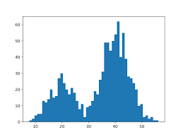
Word-Level KD
E2E SLT (Student)
MT
(Teacher)
During training

Slide 166
Word-Level KD
E2E SLT (Student)
MT
(Teacher)
During training

Slide 167
Word-Level KD
E2E SLT (Student)
MT
(Teacher)
During training
KL(ST₁, MT₁)

Slide 168
Word-Level KD
E2E SLT (Student)
MT
(Teacher)
During training
KL(ST₁, MT₁)
KL(ST₂, MT₂)

Slide 169
Word-Level KD
E2E SLT (Student)
MT
(Teacher)
During training
KL(ST₁, MT₁)
KL(ST₂, MT₂)
...

Slide 170
Word-Level KD
Training with SLT and KD losses
Goal:
matching the output of SLT ground-truth
matching also the output probabilities of teacher model

Slide 171
Sequence Level KD (Seq-KD)
The output of the teacher is used as reference
This is the content of the speech
E2E SLT (Student)
MT
(Teacher)
Training on the Teacher Output

Slide 172
Sequence Level KD (Seq-KD)
The output of the teacher is used as reference
This is the content of the speech
E2E SLT (Student)
MT
(Teacher)
Questo e’ il contenuto
del discorso

Slide 173
Sequence Level KD (Seq-KD)
The output of the teacher is used as reference
E2E SLT (Student)
MT
(Teacher)
Questo e’ il contenuto
del discorso

Slide 174
Sequence Interpolation (Seq-Inter)
The n-bests of the teacher are rescored
This is the content of the speech
E2E SLT (Student)
MT
(Teacher)
Training on the Rescored Teacher Output

Slide 175
Sequence Interpolation (Seq-Inter)
The n-bests of the teacher are rescored
This is the content of the speech
E2E SLT (Student)
MT
(Teacher)
Questo e’ il contenuto del discorso
Questo e’ il contenuto dell’audio
Questo e’ il contenuto

Slide 176
Sequence Interpolation (Seq-Inter)
The n-bests of the teacher are rescored
This is the content of the speech
E2E SLT (Student)
MT
(Teacher)
Questo e’ il contenuto dell’audio
Re-ranked n-best
Questo e’ il contenuto del discorso
Questo e’ il contenuto

Slide 177
Sequence Interpolation (Seq-Inter)
The n-bests of the teacher are rescored
E2E SLT (Student)
MT
(Teacher)
Questo e’ il contenuto
dell’audio

Slide 178
Sequence Interpolation (Seq-Inter)
How to rescore:
BLEU using SLT data for which there is the reference
Other methods: e.g. quality estimation (using ASR data)
Goal:
To add knowledge from the teacher
To reduce the lexical variability in the data (MT outputs have less variability)

Slide 179
Sequence Interpolation (Seq-Inter)
How to rescore:
BLEU using SLT data for which there is the reference
Other methods: e.g. quality estimation (using ASR data)
Goal:
To add knowledge from the teacher
To reduce the lexical variability in the data (MT outputs have less variability)

Slide 180
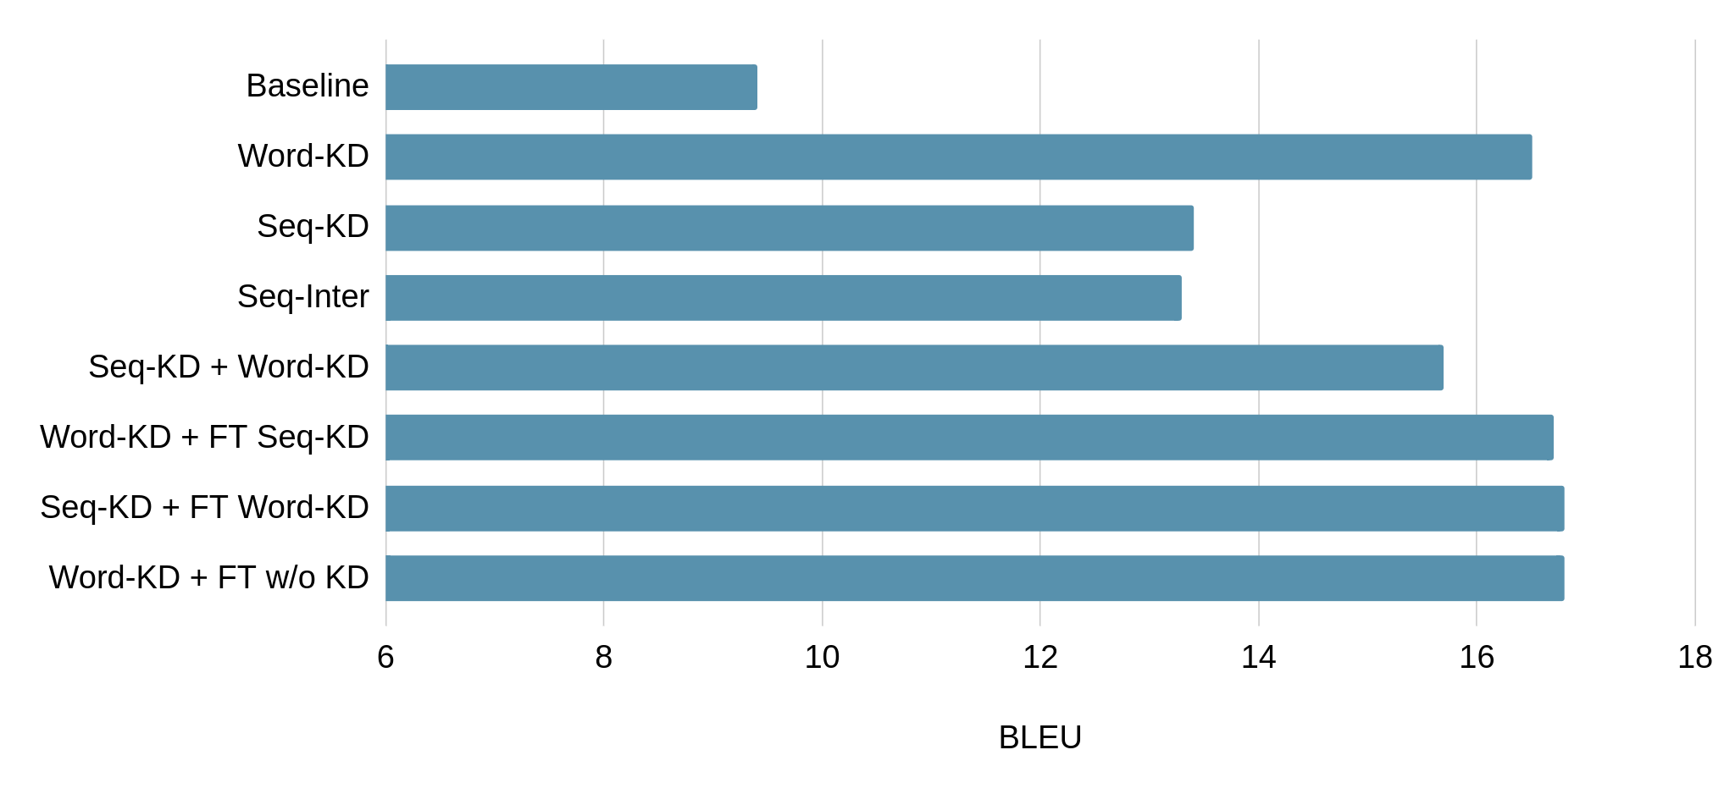
KD Methods (Gaido et al., 2020)
Word KD works the best

Slide 181
KD Methods (Gaido et al., 2020)
Word KD with a fine-tuning slightly improves over word KD

Slide 182
Pre-training vs KD (Liu et al., 2019)
Baseline
Pre-training
Word-KD
KD outperforms pre-training

Slide 183
Sec 3.3
Alternate Data Representations

Slide 184
[Recall] Speech vs. Text
Speech features ~8-10x longer than the equivalent character sequences
c h a r a c t e r s
Discretized audio –– speech frames
SPEECH:
p
…
TEXT:
p
p
frames
Challenges:
Sequence length
Sequence redundancy
Speech feature variation
o
…
frames
Each feature vector is unique, Number of feature vectors per phone varies

Slide 185
A Closer Look
speech features
EH
EH
EH
EH
EH
S
S
S
S
S
S
S
S
T
T
T
AH
AH
AH
AH
OH
OH
OH
OH
N
N
N
N
N
N
N
EH
S
T
AH
OH
N
[Esta es una oración]

Slide 186
ST Architectures
CASCADE
END-TO-END
ASR
transcript
ST
MT
translation
translation
sentence

Slide 187
ST Architectures
CASCADE
END-TO-END
Phone Cascade
Recall: Redundancy
Translating redundant phone sequences:
performs 13% worse than uniqued:
EH
EH
EH
EH
EH
S
S
S
S
S
S
S
S
T
T
T
AH
AH
AH
AH
ASR
ASR
EH S T AH
transcript
ST
phones
MT
MT
translation
translation
translation
sentence
sɛntəns
(Salesky et al. 2020)
Notes:
Translating the full sequence of redundant frame-level phone labels, for the full 160hr dataset, all models performed on average 0.6 BLEU worse; for 40hr, 1.8 BLEU worse; and with 20 hours, 4.1 BLEU worse – a 13% decrease in performance solely from non-uniqued sequences.

Slide 188
ST Architectures
CASCADE
END-TO-END
Phone Cascade
Phone Factored
⊕
ASR
ASR
R
OH
H
OH
transcript
ST
phones
ST
MT
MT
translation
translation
translation
translation
sentence
sɛntəns
(Salesky et al. 2020)

Slide 189
ST Architectures
CASCADE
END-TO-END
Phone Cascade
Phone Factored
Phone Compression
⊕
R
OH
H
OH
ASR
ASR
R
OH
H
OH
transcript
ST
phones
ST
ST
MT
MT
translation
translation
translation
translation
translation
sentence
sɛntəns
(Salesky et al. 2020; Salesky et al. 2019)

Slide 190
Methods
Phone Compression
Detecting ‘phone’ units:
ASR alignment* (Salesky et al. 2019)
Adaptive feature selection (AFS)* (Zhang et al. 2020)
CTC loss applied in encoder (Gaido et al. 2021) *require an additional model
R
OH
H
OH
Compression:
Averaging
Skip (select key-frame only)
Softmax
Weighted projection
ST
translation
(Salesky et al. 2019; Zhang et al. 2020; Gaido et al. 2021)

Slide 191
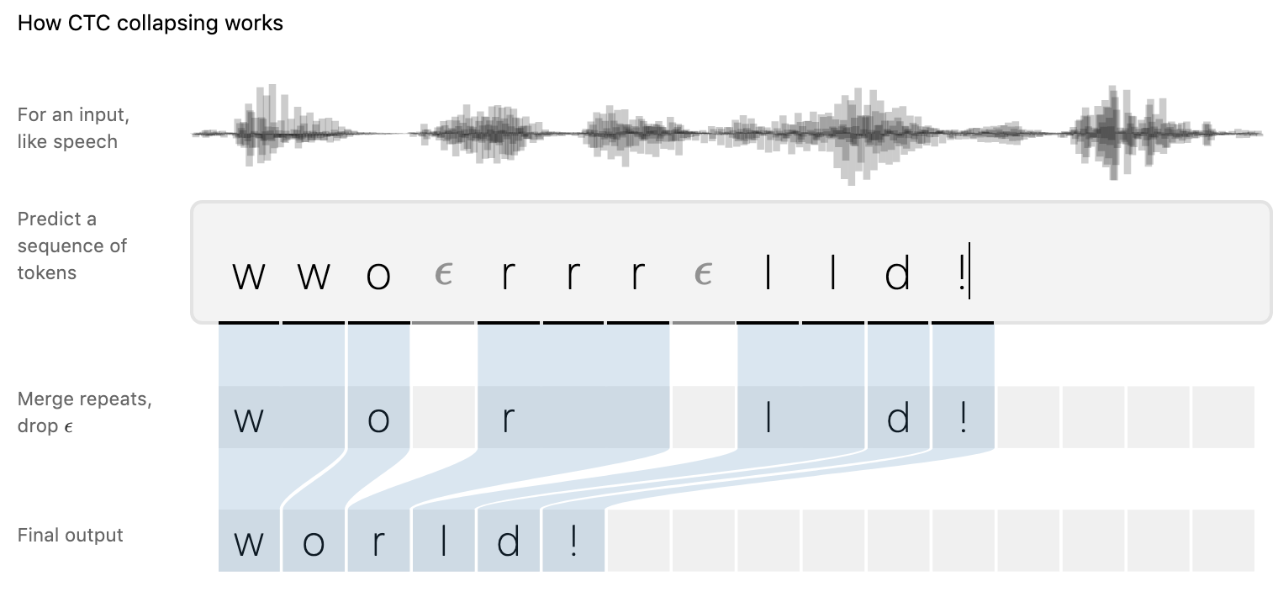
Methods
Phone Compression
R
OH
H
OH
ST
translation
(Hannun et al. 2017) — https://distill.pub/2017/ctc

Slide 192
Results
Larger datasets
Librispeech English—French
MuST-C English—German+
~400 hours of speech with translations, transcripts
Performance Improvements
Improvements of 1-2 BLEU
Computation reduction:
AFS: temporal reduction by 80%
CTC: overall computation reduced by ~10%
Training and inference time reductions
(Zhang et al. 2020; Gaido et al. 2021)

Slide 193
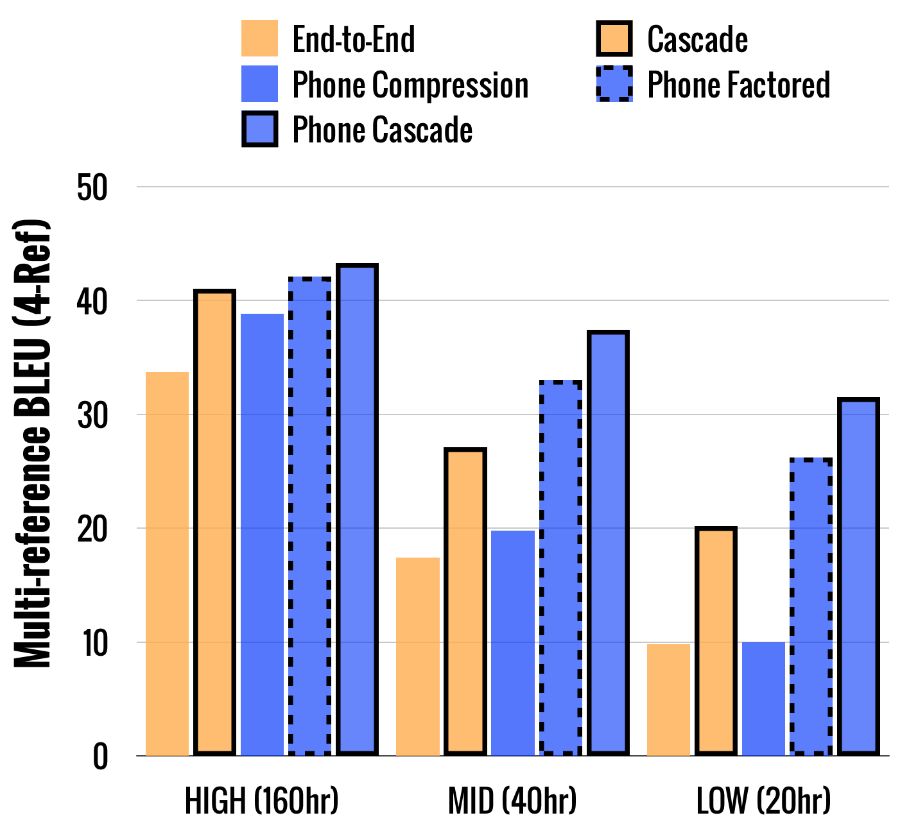
Results
(1-Ref)
Fisher Spanish—English (160 hours)
(Salesky et al. 2019; Salesky et al. 2020)

Slide 194
Sec 4: Evaluation
Automatic Metrics
Utterance segmentation
Mitigating error due to speaker variation

Slide 195
Sec 4.1
Automatic Metrics

Slide 196
Evaluation
Motivated by evaluation in machine translation
Automatic evaluation
Cheap
Fast
Human evaluation
Gold standard
Subjective
Expensive, time-consuming

Slide 197
Automatic metrics
Reuse Text MT-based metrics
BLEU
Compare reference translation to output
Multi-task system
Word error rate (WER) of transcription
Single correct output
Often calculated ignoring punctuation and case

Slide 198
BLEU
Compare Hypothesis to reference translation
Geometric mean of n-gram precision (1 to 4-grams)
Using case- and punctuation information
Reference: BLEU is a MT metric
Hypothesis: BLEU is my metric

Slide 199
BLEU
Compare Hypothesis to reference translation
Geometric mean of n-gram precision (1 to 4-grams)
Using case- and punctuation information
Reference: BLEU is a MT metric
Hypothesis: BLEU is my metric
1-gram: 3/4
2-gram: 1/3
3-gram: 0/2
4-gram: 0/1
BLEU = ∜3/4*1/3*0*0*BP

Slide 200
BLEU
Compare Hypothesis to reference translation
Geometric mean of n-gram precision (1 to 4-grams)
Using case- and punctuation information
Aggregated scores over large dataset
“Brevity penalty” to account for recall
Reference: BLEU is a MT metric
Hypothesis: BLEU is my metric
1-gram: 3/4
2-gram: 1/3
3-gram: 0/2
4-gram: 0/1
BLEU = ∜3/4*1/3*0*0*BP

Slide 201
Word error rate (WER)
Align reference and hypothesis
Calculate insertions, deletions and substitutions
Divide by reference length
Often ignoring case and punctuation
Reference: WER is an ASR metric
Hypothesis: WER is my *** metric

Slide 202
Word error rate (WER)
Align reference and hypothesis
Calculate insertions, deletions and substitutions
Divide by reference length
Often ignoring case and punctuation
Reference: WER is an ASR metric
Hypothesis: WER is my *** metric
Alignment: S D

Slide 203
Word error rate (WER)
Align reference and hypothesis
Calculate insertions, deletions and substitutions
Divide by reference length
Often ignoring case and punctuation
Reference: WER is an ASR metric
Hypothesis: WER is my *** metric
Alignment: S D
S+D+I 2
WER = =
N 5

Slide 204
Sec 4.2
Utterance Segmentation

Slide 205
Utterance segmentation
SLT evaluation has an additional level of complexity compared to machine translation.

Slide 206
Utterance segmentation
SLT evaluation has an additional level of complexity compared to machine translation.
Machine Translation:
Document:
This is an audio signal. In the training data it was split using strong punctuation. Three sentences in total.

Slide 207
Utterance segmentation
SLT evaluation has an additional level of complexity compared to machine translation.
Machine Translation:
Document:
This is an audio signal. In the training data it was split using strong punctuation. Three sentences in total.
Source sentences:
This is an audio signal.
In the training data it was split using strong punctuation.
Three sentences in total!

Slide 208
Utterance segmentation
SLT evaluation has an additional level of complexity compared to machine translation.
Machine Translation:
Document:
This is an audio signal. In the training data it was split using strong punctuation. Three sentences in total.
Source sentences:
Reference sentence:
This is an audio signal.
Questo e’ un segnale audio.
In the training data it was split using strong punctuation.
Nei dati di training e’ stato diviso usando la punteggiatura forte.
Three sentences in total!
Tre frasi in totale!

Slide 209
Utterance segmentation
SLT evaluation has an additional level of complexity compared to machine translation.
Machine Translation:
Source sentences:
MT sentences:
Reference sentence:
This is an audio signal.
Questo è un segnale audio.
Questo e’ un segnale audio.
In the training data it was split using strong punctuation.
Nei dati di allenamento è stato suddiviso utilizzando una forte punteggiatura.
Nei dati di training e’ stato diviso usando la punteggiatura forte.
Three sentences in total!
3 frasi in totale!
Tre frasi in totale!

Slide 210
Utterance segmentation
SLT evaluation has an additional level of complexity compared to machine translation.
Machine Translation:
Source sentences:
MT sentences:
Reference sentence:
This is an audio signal.
Questo è un segnale audio.
Questo e’ un segnale audio.
In the training data it was split using strong punctuation.
Nei dati di allenamento è stato suddiviso utilizzando una forte punteggiatura.
Nei dati di training e’ stato diviso usando la punteggiatura forte.
Three sentences in total!
3 frasi in totale!
Tre frasi in totale!

Slide 211
Utterance segmentation
Spoken Language Translation:
Source input:
t h i s i s a n a u d i o s i g n a l i n t h e t r a i n i n g d a t a i t w a s s p l i t u s i n g s t r o n g p u n c t u a t i o n t h r e e s e n t e n c e s i n t o t a l

Slide 212
Utterance segmentation
Spoken Language Translation:
Source input:
t h i s i s a n a u d i o s i g n a l i n t h e t r a i n i n g d a t a i t w a s s p l i t u s i n g s t r o n g p u n c t u a t i o n t h r e e s e n t e n c e s i n t o t a l
Reference sentences:
This is an audio signal.
In the training data it was split using strong punctuation.
Three sentences in total!

Slide 213
Utterance segmentation
SLT outputs depend on the segmentation of the audio input:
This is an audio
Signal in the training data was split.
Using strong punctuation, 3 sentences in total!

Slide 214
Utterance segmentation
SLT outputs depend on the segmentation of the audio input:
This is an audio
Signal in the training data was split.
Using strong punctuation, 3 sentences in total!
This is an audio signal in the training data.
It was split using strong punctuation.
Three sentences in total!

Slide 215
Utterance segmentation
SLT outputs depend on the segmentation of the audio input:
This is an audio
Signal in the training data was split.
Using strong punctuation, 3 sentences in total!
This is an audio signal in the training data.
It was split using strong punctuation.
Three sentences in total!
This is a signal.
In the training data.
It was split in three sentences.

Slide 216
Utterance segmentation
SLT outputs depend on the segmentation of the audio input:
This is an audio
Signal in the training data was split.
Using strong punctuation, 3 sentences in total!
This is an audio signal in the training data.
It was split using strong punctuation.
Three sentences in total!
This is a signal.
In the training data.
It was split in three sentences.
This is
Signal. In the training data
it was split using strong punctuation.
Three sentences
in total!

Slide 217
Utterance segmentation
SLT outputs depend on the segmentation of the audio input:
This is an audio
Signal in the training data was split.
Using strong punctuation, 3 sentences in total!
This is an audio signal in the training data.
It was split using strong punctuation.
Three sentences in total!
This is a signal.
In the training data.
It was split in three sentences.
This is
Signal. In the training data
it was split using strong punctuation.
Three sentences
in total!
Reference sentences:
This is an audio signal.
In the training data it was split using strong punctuation.
Three sentences in total!

Slide 218
SLT output - reference alignment
How to compare the automatically split SLT outputs with the manually split references?
How to compare different systems splitting the SLT outputs in different ways?
Issues:
Different number of sentences
Truncated SLT sentences
Missing large parts in the SLT outputs
Insertion of additional text in the SLT outputs

Slide 219
SLT output - reference alignment
How to compare the automatically split SLT outputs with the manually split references?
How to compare different systems splitting the SLT outputs in different ways?
Issues:
Different number of sentences
Truncated SLT sentences
Insertion of additional text in the SLT outputs
Missing large parts in the SLT outputs

Slide 220
Concatenation
SLT output:
This is
Signal. In the training data
it was split using strong punctuation.
Three sentences
in total!
Reference sentences:
This is an audio signal.
In the training data it was split using strong punctuation.
Three sentences in total!

Slide 221
Concatenation
SLT output:
This is Signal . In the training data it was split using strong punctuation . Three sentences in total !
Reference sentences:
This is an audio signal . In the training data it was split using strong punctuation . Three sentences in total !
The concatenated STL outputs (references) are considered as a single sentence.
Automatic metrics applied on two strings.
Much less precise than working at segment level, but fast to implement

Slide 222
Automatic re-segmentation algorithm
SLT output:
This is Signal . In the training data it was split using strong punctuation . Three sentences in total !
Reference sentences:
This is an audio signal . In the training data it was split using strong punctuation . Three sentences in total!

Slide 223
Automatic re-segmentation algorithm
SLT output:
This is Signal . In the training data it was split using strong punctuation . Three sentences in total !
Reference sentences:
This is an audio signal . <eos> In the training data it was split using strong punctuation . <eos> Three sentences in total ! <eos>

Slide 224
Automatic re-segmentation algorithm
This is Signal . In the training data it was split using strong punctuation . Three sentences in total !
...
...
This is an audio signal . <eos> In the training data it was split using strong punctuation . <eos> Three sentences in total ! <eos>

Slide 225
Automatic re-segmentation algorithm
This is Signal . In the training data it was split using strong punctuation . Three sentences in total !
...
...
This is an audio signal . <eos> In the training data it was split using strong punctuation . <eos> Three sentences in total ! <eos>

Slide 226
Automatic re-segmentation algorithm
This is Signal . In the training data it was split using strong punctuation . Three sentences in total !
...
...
This is an audio signal . <eos> In the training data it was split using strong punctuation . <eos> Three sentences in total ! <eos>
Based on the word alignments and <eos>, the SLT output and reference are segmented.
Alignment and segmentation in one step using the Levenshtein distance (Matuzov et al., 2015).
New segments used to compute the automatic metrics.

Slide 227
Sec 4.3
Mitigating error — Gender bias
Notes:
Let’s now focus on a specific aspect of ST systems’ evaluation: the capability to translate gender

Slide 228
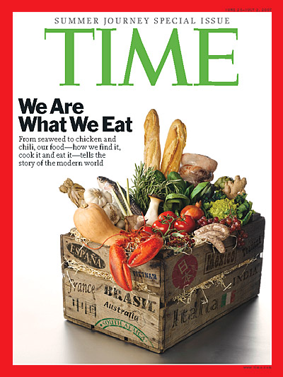
Gender and data
Training Data
Notes:
Systems reflect the data they are trained on…
...if data are balanced across relevant categories and phenomena, systems will be unbiased…
...if data are unbalanced, systems will reflect their biases.

Slide 229
Gender and data
Training Data
Training Data
Training Data
Notes:
Systems reflect the data they are trained on…
...if data are balanced across relevant categories and phenomena, systems will be unbiased…
...if data are unbalanced, systems will reflect their biases.

Slide 230
Gender and data
Training Data
Training Data
Training Data
~ 70% of the TED speakers is male
Most of the ASR and MT data are generated by male speakers
Notes:
~ 70% of the TED speakers is male
The peak of women’s representation in the EU Parl. has been 40%
Most of the ASR and MT data are generated by male speakers

Slide 231
Gender and translation
How do languages convey the gender of a referred entity?
English:
Natural Gender Language
Italian/French:
Grammatical Gender Languages
Pronouns (he/she)
Lexical gender (boy/girl)
Gender-marked titles (actor/actress)
Overtly express feminine/masculine gender on numerous POS
she is a good friend
he is a good friend
è una buona amica (Fem.)
è un buon amico» (Masc.)
?
I’m a good friend

Slide 232
Gender bias: a technical and ethical problem
“I’m a good friend” | Correct Italian translation | Most probable automatic translation
M: “Sono un_ buon_ amico”
F: “Sono una buona amica”

Slide 233
Gender bias: a technical and ethical problem
“I’m a good friend” | Correct Italian translation | Most probable automatic translation
M: “Sono un_ buon_ amico”
F: “Sono una buona amica”
Independently from the speaker

Slide 234
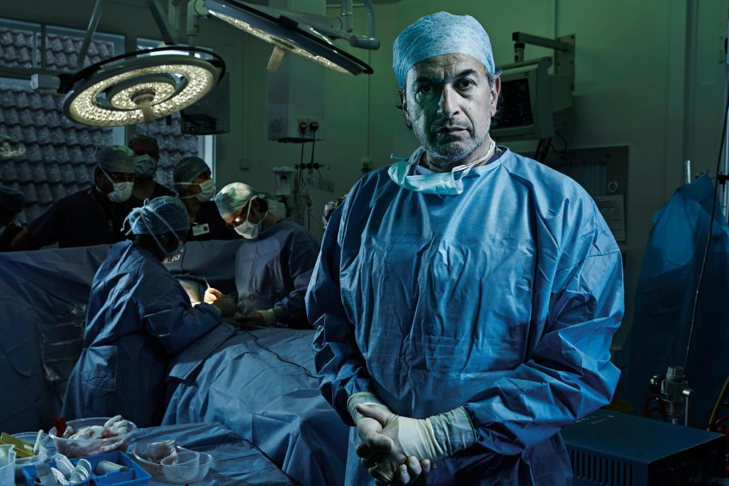
Gender bias: a technical and ethical problem
“I’m a good friend” | Correct Italian translation | Most probable automatic translation
M: “Sono un_ buon_ amico”
F: “Sono una buona amica”
Independently from the speaker
Bias in the training data…
...pushes systems towards a “male default”…
...amplifying social asymmetries!
Heart surgeon
Nurse

Slide 235
Gender bias and automatic translation
Machine Translation (text-to-text)
→ textual input does NOT always provide gender clues
Speech Translation (speech-to-text)
→ audio input can provide gender clues
I’m a good friend
I’m a good friend
Are ST systems able to exploit audio information to translate gender?

Slide 236
Gender bias and ST - exploiting audio features
Bentivogli et al., “Gender in Danger? Evaluating Speech Translation Technology on the MuST-SHE Corpus”, ACL 2020
MuST-SHE: a benchmark for the analysis of gender translation in MT and ST
Gender-sensitive evaluation methodology
Comparison between end-to-end and cascade ST approaches
Derived from MuST-C (2 language directions En→It, En→Fr)
Gender-sensitive design: each segment contains 1+ English gender-neutral word translated into the corresponding masculine/feminine target word(s)
2 gender phenomena: info-in-audio (I’m a good friend), info-in-content (she is a good...)

Slide 237
Gender bias and ST - exploiting audio features
Bentivogli et al., “Gender in Danger? Evaluating Speech Translation Technology on the MuST-SHE Corpus”, ACL 2020
MuST-SHE: a benchmark for the analysis of gender translation in MT and ST
Gender-sensitive evaluation methodology based on “gender swapping”
Comparison between end-to-end and cascade ST approaches
BLEU/Accuracy scores computed against correct and wrong references
Src: I have been to London (female speaker)
C-Ref: Io sono stata a Londra,
W-Ref: Io sono stato a Londra
Difference between correct and wrong reference as a measure of gender translation performance (the higher the better -- lower bias!)

Slide 238
Gender bias and ST - exploiting audio features
Bentivogli et al., “Gender in Danger? Evaluating Speech Translation Technology on the MuST-SHE Corpus”, ACL 2020
MuST-SHE: a benchmark for the analysis of gender translation in MT and ST
Gender-sensitive evaluation methodology based on “gender swapping”
Comparison between end-to-end and cascade ST approaches
Translation quality (BLEU): cascade better than e2e
Gender translation (BLEU+gender swapping): the two perform on par
Gender translation (Accuracy+gender swapping) on info-in-audio samples:
e2e much better than simple cascade
leveraging audio features ⇨ethical issues (vocally impaired, transgender)?
Notes:
e2e much better than simple cascade (ability to leverage audio features? ⇨Ethical issues?)
...But what if gender information IS available? Next work...

Slide 239
Gender bias and ST - exploiting speakers’ info
Gaido et al., “Breeding Gender-aware Direct Speech Translation Systems”, Coling 2020
MuST-Speakers: annotation of MuST-SHE with speakers’ gender information
Notes:
Different condition, where speakers’ gender IS KNOWN.
pure models relying on speaker’s BIOMETRIC FEATURES (voice) can be problematic (children, vocally impared or transgender individuals)
How can we exploit external speakers’ information to improve gender translation in direct ST?
Beyond speech signals, can we control gender translation in ST?

Slide 240
Gender bias and ST - exploiting speakers’ info
Gaido et al., “Breeding Gender-aware Direct Speech Translation Systems”, Coling 2020
MuST-Speakers: annotation of MuST-SHE with speakers’ gender information
Comparison of different e2e ST systems
Base: Generic, “gender-unaware” ST model
Multi-gender: single model informed of the speaker’s gender via pre-pended gender tokens
Gender-specialized: two models, fine-tuned on utterances spoken by men/women
Overall translation quality (BLEU): small differences
Gender translation (Accuracy+gender swapping) on info-in-audio samples (I’m a good friend):
Specialized >> Multi-gender >> Base
Notes:
...Specialized more flexible when speech signals should be ignored
...Specialized best integration strategy, able to ignore speech signal
This was an example of how a focused evaluation scheme can be designed to spot strengths and limitations of cascade and e2e technology and to orient ST development towards better performance on a specific linguistic aspect (a fair translation of gender).

Slide 241
Sec 5: Advanced topics
Utterance segmentation
Multilingual ST
Under-resourced languages

Slide 242
Sec 5.1
Utterance Segmentation

Slide 243
Utterance segmentation - Problem
Mismatch between training and evaluation data
Training corpora: “sentence-level” split of continuous speech
This is an audio signal.
In the training data it was split using strong punctuation.
Three sentences in total!
Notes:
In the training data it was split using strong punctuation. SINCE WE HAVE GOLD TRANSCRIPTS with punctuation, we can manually segment training data!!!

Slide 244
Utterance segmentation - Problem
Mismatch between training and evaluation data
Training corpora: “sentence-level” split of continuous speech
At run-time: unsegmented continuous speech
This is an audio signal.
In the training data it was split using strong punctuation.
Three sentences in total!
t h i s i s a n a u d i o s i g n a l i n t h e t r a i n i n g d a t a i t w a s s p l i t u s i n g s t r o n g p u n c t u a t i o n t h r e e s e n t e n c e s i n t o t a l

Slide 245
How to split continuous speech in cascade ST?
t h i s i s a n a u d i o s i g n a l i n t h e t r a i n i n g d a t a i t w a s s p l i t
u s i n g s t r o n g p u n c t u a t i o n t h r e e s e n t e n c e s i n t o t a l
ASR
this is an audio signal in the training data it was split
using strong punctuation three sentences in total
Re-segmentation component
this is an audio signal.
in the training data it was split using strong punctuation.
three sentences in total!
MT
Matusov et al.: “Automatic Sentence Segmentation and Punctuation Prediction for Spoken Language Translation”, IWSLT`06
Notes:
An initial split based on silences…
...is passed to the ASR, which produces two transcripts (for the ASR it’s not critical if context is missing due to intra-sentential splits! Different from MT, it only has to transcribe what was said)...
THEN, a re-segmentation component re-organizes the transcripts adding strong punctuation…
...The re-segmented text is finally passed to the MT component.

Slide 246
How to split continuous speech in e2e ST?
t h i s i s a n a u d i o s i g n a l i n t h e t r a i n i n g d a t a i t w a s s p l i t u s i n g s t r o n g p u n c t u a t i o n t h r e e s e n t e n c e s i n t o t a l

Slide 247
Solution 1: Split on silences (via VAD)
t h i s i s a n a u d i o s i g n a l i n t h e t r a i n i n g d a t a i t w a s s p l i t u s i n g s t r o n g p u n c t u a t i o n t h r e e s e n t e n c e s i n t o t a l
this is an audio signal
in the training data it was split using strong punctuation
three sentences
in total
Notes:
Few words about VAD?
VAD tools are classifiers that determine whether a given audio frame contains speech or not. Based on this, a VAD-based segmentation considers a sequence of consecutive speech frames as a segment, filtering out non-speech frames.
Two widely used open source VAD tools:
LIUM --- S. Meignier and T. Merlin, “LIUM SpkDiarization: An Open Source Toolkit For Diarization,” in Proceedings of the CMU SPUD Workshop, Dallas, Texas, 2010.
WebRTC --- WebRTC takes as parameters the frame size (10, 20 or 30ms) and the aggressiveness mode (an integer in the range [0, 3], 3 being the most aggressive)

Slide 248
Solution 1: Split on silences (via VAD)
t h i s i s a n a u d i o s i g n a l i n t h e t r a i n i n g d a t a i t w a s s p l i t u s i n g s t r o n g p u n c t u a t i o n t h r e e s e n t e n c e s i n t o t a l
this is an audio signal
in the training data it was split using strong punctuation
three sentences
in total
Advantage: silences as a proxy of sentence boundaries
Drawback: variable segments’ length (including very short and very long ones)
Notes:
VAD-based (speaker silences considered as a proxy of clause boundaries. not driven by syntactic information),
Limits:
(1) splitting is not lead by linguistic criteria related to sentence well-formedness
(2) segments of variable length (incl. very long/short) -- BUT audio segments’ length is a crucial factor to obtain good translations (short→ hallucinations, long→ untranslated portions)

Slide 249
Solution 2: Split based on fixed audio duration
t h i s i s a n a u d i o s i g n a l i n t h e t r a i n i n g d a t a i t w a s s p l i t u s i n g s t r o n g p u n c t u a t i o n t h r e e s e n t e n c e s i n t o t a l
this is an audio signal in the tra
ining data it was split using strong pu
nctuation three sentences in total

Slide 250
Solution 2: Split based on fixed audio duration
t h i s i s a n a u d i o s i g n a l i n t h e t r a i n i n g d a t a i t w a s s p l i t u s i n g s t r o n g p u n c t u a t i o n t h r e e s e n t e n c e s i n t o t a l
this is an audio signal in the tra
ining data it was split using strong pu
nctuation three sentences in total
Advantage: uniform segment length
Drawback #1: split points are likely to break the input in critical positions
Drawback #2: non-speech frames are kept in the input
Notes:
fixed length
Advantage: (In contrast with VAD, this naive method has the benefit of ensuring that the resulting segments are not too long or too short, which are typically hard conditions for ST systems.
Limits
(1) the (sub-optimal) split points are likely to break sentences in critical positions such as between a subject and a verb or even in the middle of a word.
(2) non speech events are passed to the system. Noise? Useless information?

Slide 251
Solution 3: Split on silences & segments’ length
Potapczyk and Przybysz: “SRPOL’s system for the IWSLT 2020 end-to-end speech translation task”, IWSLT 2020
this is an audio signal in the training data it was split
using strong punctuation three sentences in total
this is an audio signal
in the training data it was split
using strong punctuation
three sentences in total
Notes:
This method takes into account both audio content (silences) and target segments’ length (i.e. the desired length of the generated segments) to split the audio. It recursively divides the audio segments on the longest silence, until either there are no more silences in a segment, or the segment itself is shorter than a threshold.
Drawbacks:
Silences are detected with a manual operation, making the approach hard to reproduce and not scalable.
Another major problem of this method is that it requires the full audio to be available for splitting it. So it is not applicable to audio streams and online use cases.

Slide 252
Solution 3: Split on silences & segments’ length
Potapczyk and Przybysz: “SRPOL’s system for the IWSLT 2020 end-to-end speech translation task”, IWSLT 2020
this is an audio signal in the training data it was split
using strong punctuation three sentences in total
this is an audio signal
in the training data it was split
using strong punctuation
three sentences in total
Advantages: closer to sentence-like splits, uniform segment length
Drawback #1: manually-detected silences (non scalable/reproducible)
Drawback #2: full audio required for splitting (not applicable to audio streams)
Notes:
This method takes into account both audio content (silences) and target segments’ length (i.e. the desired length of the generated segments) to split the audio. It recursively divides the audio segments on the longest silence, until either there are no more silences in a segment, or the segment itself is shorter than a threshold.
Drawbacks:
Silences are detected with a manual operation, making the approach hard to reproduce and not scalable.
Another major problem of this method is that it requires the full audio to be available for splitting it. So it is not applicable to audio streams and online use cases.

Slide 253
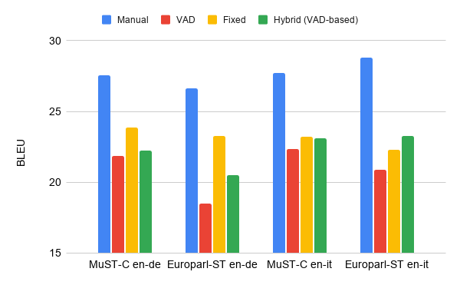
Utterance segmentation - An open problem
Large room for improvement compared to manual segmentation
Notes:
3-6 BLEU points between MANUAL and the best automatic segmentation method on all language pairs!

Slide 254
Utterance segmentation - An open problem
FIXED length surprisingly good
→ segments’ length is more important than precise split times
Notes:
In 3 out of 4 cases, FIXED achieves the best results!

Slide 255
Utterance segmentation - An open problem
Fully automatic hybrid segmentation?
→ better than VAD, better than FIXED on one language pair
Notes:
DIRECTIONS:
Improve HYBRID without manual intervention → would enhance reproducibility and scalability
...which would be open also to simultaneous ST!!!
Open issues:
Avoid manual intervention (e.g. to detect silences as in SRPOL) → reproducibility, scalability
Avoid requiring the full audio to be available for splitting (unapplicable to smultaneous ST)

Slide 256
Sec 5.2
Multilingual ST

Slide 257
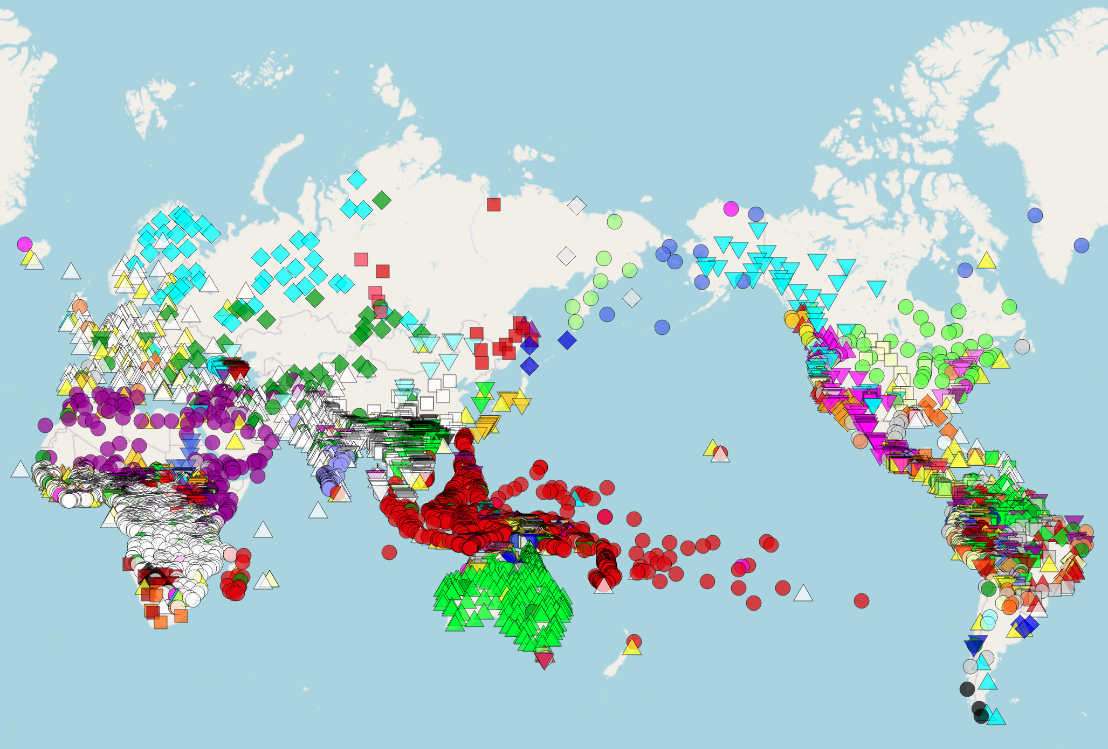
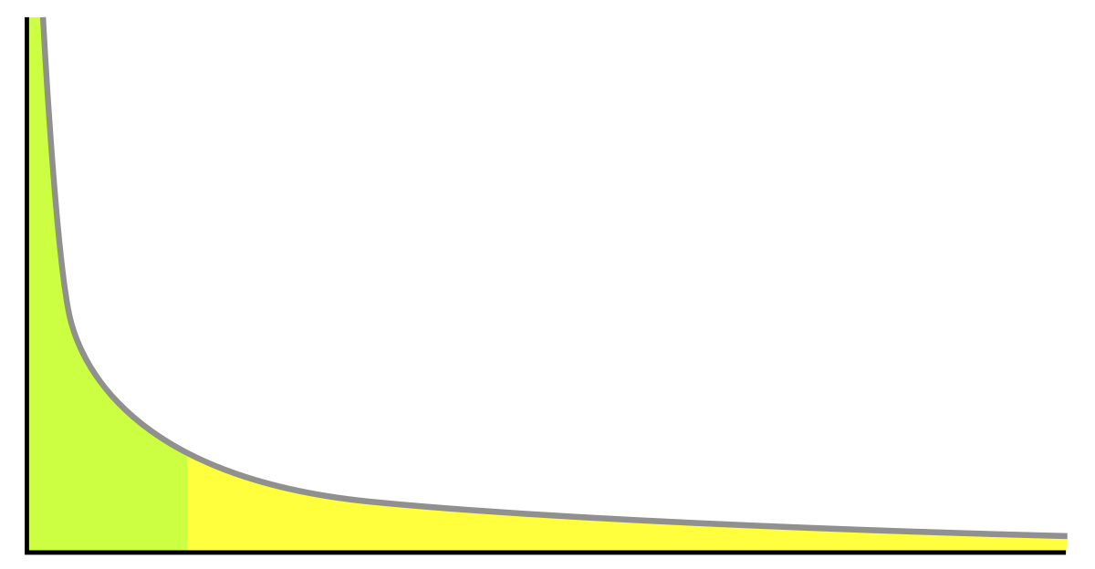
Multilingual ST
Most research focuses on few languages
More than 7,000 languages in the world
Challenges:
Scale to many languages
Limited resources

Slide 258
Multilingual ST
Idea:
Single model for many languages
Motivated by text translation
Advantages:
Less training data necessary
Handle several languages by single model
Zero-shot direction:
Translate between languages without training data
Multi-lingual ST

Slide 259
Multilingual ST
Scenarios:
Many-to-One
Multi-lingual ST

Slide 260
Multilingual ST
Scenarios:
Many-to-One
One-to-Many
Multi-lingual ST

Slide 261
Multilingual ST
Scenarios:
Many-to-One
One-to-Many
Many-to-Many
Multi-lingual ST

Slide 262
Multilingual ST
Scenarios:
Many-to-One
One-to-Many
Many-to-Many
Zero-shot:
No training data in test language pair
Multi-lingual ST
Training direction
Test direction

Slide 263
Multilingual ST - Architecture
Individual encoder and decoder for each language
(e.g. Escolano et al. 2020)
Decoder
Decoder
Decoder
Encoder
Encoder
Encoder

Slide 264
Multilingual ST - Architecture
Joint encoder and decoder
Di Gangi et al., 2019
Inaguma et al., 2019
Challenge:
How to model different languages?
Decoder
Encoder

Slide 265
Multilingual ST - Language representation
Encoder
Concat
Append learned language embedding for target language to audio features
Encoder

Slide 266
Multilingual ST - Language representation
Encoder
Concat
Append learned language embedding for target language to audio features
Merge
Repeat language embedding for target language at each time step
Encoder

Slide 267
Multilingual ST - Language representation
Encoder
Decoder
I
go
home
</s>
Decoder
<s>
I
go
home
Encoder

Slide 268
Multilingual ST - Language representation
Encoder
Decoder
Replace Begin of sentence by sentence embedding
I
go
home
</s>
Decoder
I
go
home
Encoder

Slide 269
Sec 5.3
Under-resourced Languages

Slide 270
Under-resourced languages
More than 7,000 languages spoken today
Notes:
7000 languages, only few of which have labeled data and available models. This map is from glottolog. However, there are many challenges inherent in extending models and resources to new languages and in particular, under-resourced nad under-studied languages, beyond merely collecting data

Slide 271
Under-resourced languages
What makes a language under-resourced?
Data availability: labeled data, unlabeled data, quality and representation
Data domain: coverage and representation
Noisy and/or opaque orthographies
Unwritten languages
Typological coverage:
Unique phonetic and phonological systems
Dialectal variation
Code-switching
Representation of non-native speakers
from SIGUL, Special Interest Group on Under-Resource Languages
Notes:
Porting a NLP system (for instance a speech recognition system or a syntactic parser) to a lesser-resourced language requires techniques that go far beyond the basic re-training of the models.
“Indeed, processing a new language often leads to new challenges (special phonetic and phonological systems, word segmentation problems, fuzzy grammatical structure, unwritten language, etc.). The lack of resources requires, on its side, innovative data collection methodologies (via community sourcing for instance) or models for which information is shared between languages (e.g. multilingual acoustic models) or even approaches that do not need annotated data (e.g. zero-resource or zero-shot methods). In addition, some social and cultural aspects related to the context of the targeted language bring additional problems: languages with many dialects in different regions, code-switching phenomena, massive presence of non-native speakers.” --SIGUL

Slide 272
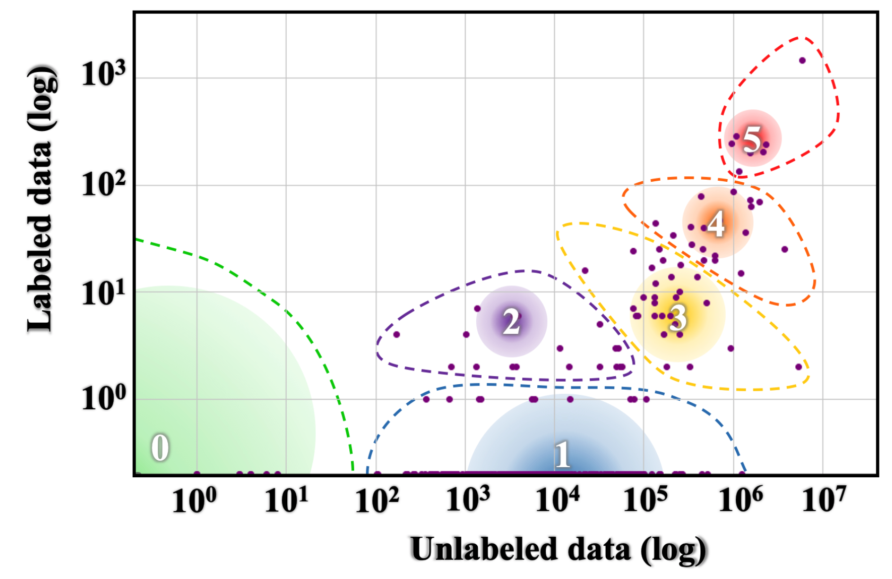
Taxonomy
0. Exceptionally limited resources: pretraining exacerbates situation
1. Some amount of unlabeled data 2. Small set of labeled data created 3. Unlabeled data enables pretraining, but limited labeled data 4. Large amount of unlabeled data, high quality but limited labeled 5. High-resource languages
Language resource distribution of Joshi et al. (2020). The size and colour of a circle represent the number of languages and speakers respectively in each category. Colours (on the VIBGYOR spectrum; Violet–Indigo–Blue– Green–Yellow–Orange–Red) represent the total speaker population size from low (violet) to high (red).
(Joshi et al. 2020)
Notes:
0. Exceptionally limited resources: pretraining ‘only makes the poor poorer’ 1. Some amount of unlabeled data 2. Small set of labeled data created 3. Unlabeled data enables pretraining, but limited labeled data 4. Large amount of unlabeled data, high quality but limited labeled 5. High-resource languages

Slide 273
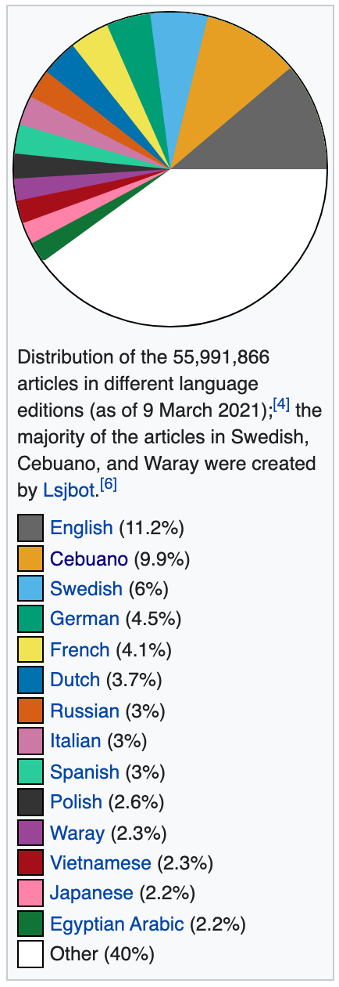
Languages: Examples
(One language from each 0-5 taxonomy level)
MuST-C -- English speech only, X phones
mTEDx -- 8 languages, Y phones
Two randomly selected languages from Glottolog:
First - Z phones, coverage in MuSTC ?%, in mTEDx, ?%
Bible Wilderness: hours vs MuST-C
Number of languages, number of speakers, and percentage of total languages for each language class
0. Dahalo: Recorded Swadesh list
1. Cherokee: Bible; 15k sentences parallel text; Tatoeba; Ubuntu
2. Zulu: Recorded word lists; Tatoeba; Ubuntu
3. Cebuano: Recorded word lists; BABEL; Bible; Wikipedia; Tatoeba; Ubuntu
4. Korean: Bible; Wikipedia; OpenSLR 40, 58, 97; Tatoeba; Ubuntu
5. English: ∀
Notes:
Porting a NLP system (for instance a speech recognition system or a syntactic parser) to a lesser-resourced language requires techniques that go far beyond the basic re-training of the models.
“Indeed, processing a new language often leads to new challenges (special phonetic and phonological systems, word segmentation problems, fuzzy grammatical structure, unwritten language, etc.). The lack of resources requires, on its side, innovative data collection methodologies (via community sourcing for instance) or models for which information is shared between languages (e.g. multilingual acoustic models) or even approaches that do not need annotated data (e.g. zero-resource or zero-shot methods). In addition, some social and cultural aspects related to the context of the targeted language bring additional problems: languages with many dialects in different regions, code-switching phenomena, massive presence of non-native speakers.” --SIGUL

Slide 274
ST: Resources Required
Two steps where resources are required: ① for training and ② for corpus creation
Labeled data: parallel speech and translations, segmented
Unlabeled data: monolingual source language speech; monolingual target language text
Pronunciation lexicons: Use: alignment, hybrid ASR models; alternate data representations; CTC loss and/or compression
Availability: MuST-C (1); mTEDx (8); CoVoST (21)
Bible (~1000); Wikipedia (285); linguistic resources often <2 hours Hand-created lexicons often unreleased; Wikipron (117); Epitran (63)
(# source languages) .
Notes:
Porting a NLP system (for instance a speech recognition system or a syntactic parser) to a lesser-resourced language requires techniques that go far beyond the basic re-training of the models.
“Indeed, processing a new language often leads to new challenges (special phonetic and phonological systems, word segmentation problems, fuzzy grammatical structure, unwritten language, etc.). The lack of resources requires, on its side, innovative data collection methodologies (via community sourcing for instance) or models for which information is shared between languages (e.g. multilingual acoustic models) or even approaches that do not need annotated data (e.g. zero-resource or zero-shot methods). In addition, some social and cultural aspects related to the context of the targeted language bring additional problems: languages with many dialects in different regions, code-switching phenomena, massive presence of non-native speakers.” --SIGUL

Slide 275
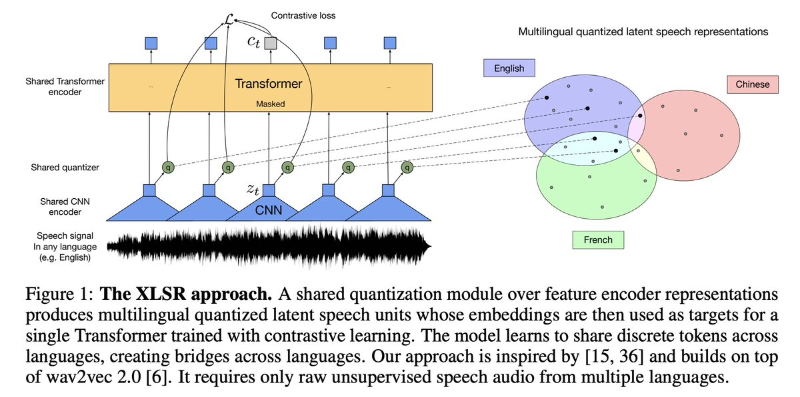
Pretrained Models
encoder
wav2vec 2.0 — XLSR
mBART
decoder
(Baevski et al. 2020; Liu et al. 2020; Li et al. 2021)
Methods previously discussed: pretraining + finetuning, knowledge distillation, alternate data representations
Dependences on shared features: in-vocabulary orthography, phone inventories, use of same model architecture
Unless we assess on under-resourced languages, we will not know how well methods apply!
Notes:
Porting a NLP system (for instance a speech recognition system or a syntactic parser) to a lesser-resourced language requires techniques that go far beyond the basic re-training of the models.
“Indeed, processing a new language often leads to new challenges (special phonetic and phonological systems, word segmentation problems, fuzzy grammatical structure, unwritten language, etc.). The lack of resources requires, on its side, innovative data collection methodologies (via community sourcing for instance) or models for which information is shared between languages (e.g. multilingual acoustic models) or even approaches that do not need annotated data (e.g. zero-resource or zero-shot methods). In addition, some social and cultural aspects related to the context of the targeted language bring additional problems: languages with many dialects in different regions, code-switching phenomena, massive presence of non-native speakers.” --SIGUL

Slide 276
Sec 6: Real-world Applications
Automatic generation of subtitles
Simultaneous translation

Slide 277
Sec 6.1
Automatic Generation of Subtitles

Slide 278
Automatic subtitling - Motivation
Explosion of audio-visual content available (Cinema, OTT platforms, social media,...)
Need: offer high-quality subtitles into dozens of languages in a short time
Problem: human subtitling is slow and costly (1-15$/min)
Goal: automatic solutions to reduce human workload and costs
Notes:
Hunger Games :-)
Translation is only one step in a long pipeline consisting of transcription, timing (also called spotting) and editing
An over-the-top (OTT) media service is a streaming media service offered directly to viewers via the Internet.

Slide 279
What is special about Subtitling?
Importance of time
Text needs to satisfy spatial and temporal constraints
In and out times based on speech rhythm
Length: max. 2 lines (of ≈ length) max. 42 characters/line
Reading speed: max. 21 characters/second
Notes:
technical aspects
Characteristics:
intersemiotic process: it involves a change of channel, medium and code from speech to writing, from spoken verbal language to written verbal language

Slide 280
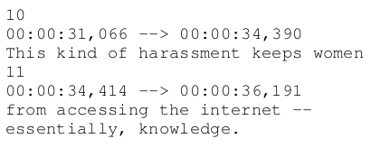
Segmenting into proper subtitles
This kind of harassment keeps women <eob> from accessing the internet – <eol> essentially, knowledge. <eob>
Notes:
These are the so-called "subtitle templates". A subtitle template is an enriched transcript of the source language speech where the text is already compressed, timed and segmented into proper subtitles. This template can serve as a basis for translation into other languages, whether the translation is performed by a human or an MT system. In the case of templates, optimal duration, length and proper segmentation are ensured, since the change of code between oral and written in the source language has already been curated by an expert.
How to decide which type of break symbol to use in order to follow the speech rhythm?
break symbol <eob>, should correspond to the end of a speech act, a pause or a terminal juncture
eol , their function is to split a long subtitle into two smaller parts in order to fit the screen (length+syntax)

Slide 281
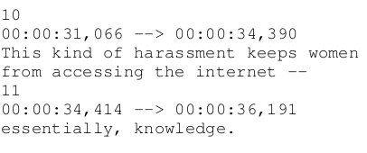
Segmenting into proper subtitles
This kind of harassment keeps women <eol> from accessing the internet – <eob> essentially, knowledge. <eob>
Notes:
How to decide which type of break symbol to use in order to follow the speech rhythm?
break symbol <eob>, should correspond to the end of a speech act, a pause or a terminal juncture
eol , their function is to split a long subtitle into two smaller parts in order to fit the screen (length+syntax)

Slide 282
Segmentation approaches
This kind of harassment keeps women <eol> from accessing the internet – <eob>
Manual template
MT
Ce harcèlement empêche les femmes <eol> d'accéder à Internet, <eob>
Notes:
A subtitle template is an enriched transcript of the source language speech where the text is already compressed, timed and segmented into proper subtitles. This template can serve as a basis for translation into other languages, whether the translation is performed by a human or an MT system. In the case of templates, optimal duration, length and proper segmentation are ensured, since the change of code between oral and written in the source language has already been curated by an expert.
Speech Recognition (ASR) systems produce word-for-word transcriptions of the source speech, not adapted to the subtitling constraints, and where all information coming from the speech is discarded….Therefore, it is highly probable that a higher post-editing effort is required not only in terms of translation errors, but chiefly for repairing the form of the subtitles.
Direct, end-to-end speech translation receives audio as input. Therefore, the model receives information about the temporal dimension of the speech, e.g. duration,... speech tempo directly affects the compression rate of subtitles, and pauses often correspond to prosodic chunks which can determine the subtitle segmentation.

Slide 283
Segmentation approaches
Previous works focused only on length-matching given the template
(Matusov et al., 2019; Lakew et al., 2019)
This kind of harassment keeps women <eol> from accessing the internet – <eob>
Manual template
MT
Ce harcèlement empêche les femmes <eol> d'accéder à Internet, <eob>
Notes:
A subtitle template is an enriched transcript of the source language speech where the text is already compressed, timed and segmented into proper subtitles. This template can serve as a basis for translation into other languages, whether the translation is performed by a human or an MT system. In the case of templates, optimal duration, length and proper segmentation are ensured, since the change of code between oral and written in the source language has already been curated by an expert.
Speech Recognition (ASR) systems produce word-for-word transcriptions of the source speech, not adapted to the subtitling constraints, and where all information coming from the speech is discarded….Therefore, it is highly probable that a higher post-editing effort is required not only in terms of translation errors, but chiefly for repairing the form of the subtitles.
Direct, end-to-end speech translation receives audio as input. Therefore, the model receives information about the temporal dimension of the speech, e.g. duration,... speech tempo directly affects the compression rate of subtitles, and pauses often correspond to prosodic chunks which can determine the subtitle segmentation.

Slide 284
Segmentation approaches
This kind of harassment keeps women <eol> from accessing the internet – <eob>
Manual template
MT
Ce harcèlement empêche les femmes <eol> d'accéder à Internet, <eob>
this kind of harassment keeps woman from accessing internet
Cascade
ASR
MT
Notes:
A subtitle template is an enriched transcript of the source language speech where the text is already compressed, timed and segmented into proper subtitles. This template can serve as a basis for translation into other languages, whether the translation is performed by a human or an MT system. In the case of templates, optimal duration, length and proper segmentation are ensured, since the change of code between oral and written in the source language has already been curated by an expert.
Speech Recognition (ASR) systems produce word-for-word transcriptions of the source speech, not adapted to the subtitling constraints, and where all information coming from the speech is discarded….Therefore, it is highly probable that a higher post-editing effort is required not only in terms of translation errors, but chiefly for repairing the form of the subtitles.
Direct, end-to-end speech translation receives audio as input. Therefore, the model receives information about the temporal dimension of the speech, e.g. duration,... speech tempo directly affects the compression rate of subtitles, and pauses often correspond to prosodic chunks which can determine the subtitle segmentation.

Slide 285
Segmentation approaches
This kind of harassment keeps women <eol> from accessing the internet – <eob>
Manual template
MT
Ce harcèlement empêche les femmes <eol> d'accéder à Internet, <eob>
this kind of harassment keeps woman from accessing internet
Cascade
ASR
MT
E2E
ST
Notes:
A subtitle template is an enriched transcript of the source language speech where the text is already compressed, timed and segmented into proper subtitles. This template can serve as a basis for translation into other languages, whether the translation is performed by a human or an MT system. In the case of templates, optimal duration, length and proper segmentation are ensured, since the change of code between oral and written in the source language has already been curated by an expert.
Speech Recognition (ASR) systems produce word-for-word transcriptions of the source speech, not adapted to the subtitling constraints, and where all information coming from the speech is discarded….Therefore, it is highly probable that a higher post-editing effort is required not only in terms of translation errors, but chiefly for repairing the form of the subtitles.
Direct, end-to-end speech translation receives audio as input. Therefore, the model receives information about the temporal dimension of the speech, e.g. duration,... speech tempo directly affects the compression rate of subtitles, and pauses often correspond to prosodic chunks which can determine the subtitle segmentation.

Slide 286
Segmentation approaches
This kind of harassment keeps women <eol> from accessing the internet – <eob>
Manual template
MT
Costly!
Ce harcèlement empêche les femmes <eol> d'accéder à Internet, <eob>
this kind of harassment keeps woman from accessing internet
Cascade
ASR
MT
Audio info (e.g. duration) is lost
E2E
ST
Audio info (e.g. duration) is available to ST
Notes:
Only 1 work on E2E, without templates!
A subtitle template is an enriched transcript of the source language speech where the text is already compressed, timed and segmented into proper subtitles. This template can serve as a basis for translation into other languages, whether the translation is performed by a human or an MT system. In the case of templates, optimal duration, length and proper segmentation are ensured, since the change of code between oral and written in the source language has already been curated by an expert.
Speech Recognition (ASR) systems produce word-for-word transcriptions of the source speech, not adapted to the subtitling constraints, and where all information coming from the speech is discarded….Therefore, it is highly probable that a higher post-editing effort is required not only in terms of translation errors, but chiefly for repairing the form of the subtitles.
Direct, end-to-end speech translation receives audio as input. Therefore, the model receives information about the temporal dimension of the speech, e.g. duration,... speech tempo directly affects the compression rate of subtitles, and pauses often correspond to prosodic chunks which can determine the subtitle segmentation.

Slide 287
Automatic subtitling - Data
OpenSubtitles (Lison and Tiedemann, 2016) -- 60 languages
Variable quality (professional/amateur subt., automatic sentence-level alignm.):
No information about subtitle breaks
No alignment with audio (mostly copyright-protected videos)
JESC (Pryzant et al., 2018) -- Ja-En
Automatic alignments (caption level = only subtitles with matching timestamps)
No alignment with audio
Must-Cinema (Karakanta et al., 2020) -- En→ 7 languages
Derived from MuST-C (TED talks)
Annotated with subtitle breaks
Audio-transcript-translation alignments
Notes:
Opensubtitles: Largest corpus - built from freely available subtitles in 60 languages.
Jesc: the integrity of the sentences is harmed since only subtitles with matching timestamps are included in the corpus, making it impossible to take advantage of a larger context.
MuST-Cinema: largest subtitling corpus available aligned to the audio.

Slide 288
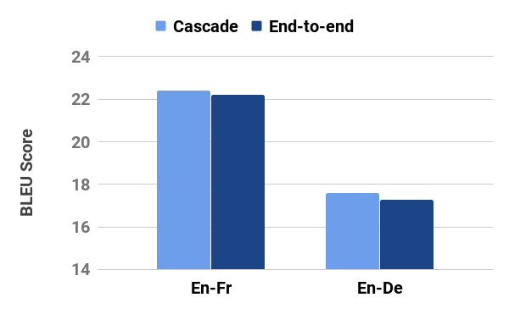
E2E subtitling: experiments on En-Fr/De
Doable?
Translation quality
No gap between Cascade and E2E
Karakanta et al., 2020 - IWSLT

Slide 289
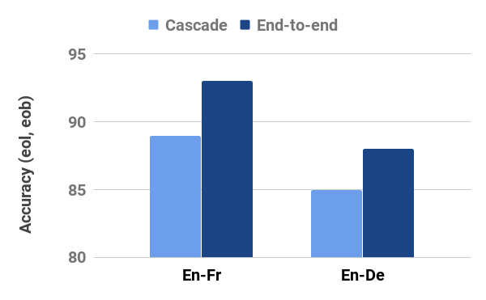
E2E subtitling: experiments on En-Fr/De
Effective?
Segmentation (<eol> and <eob> insertion)
E2E exploits acoustic information (pause duration) to insert breaks
Karakanta et al., 2020 - IWSLT
Notes:
Cascade is disadvantaged by the inability to:i) recover from possible ASR errors, and ii) make decisions determined by factors other than text.
Exploit acoustic elements (pauses’ duration)? → yes: e2e has higher accuracy in inserting <eob> and <eol>...”Prosody (pauses) helps determine the position and the correct type of break in the E2E system”

Slide 290
Sec 6.2
Simultaneous ST

Slide 291
Simultaneous Translation
Generate translation while speaker speaks
Tradeoff:
More context improves speech translation
Wait as long as possible
Low latency is important for user experience
Generate translation as early as possible
Challenge:
Different word order in the language
SOV vs SVO
German | Ich | melde | mich | zum | E2E | Tutorial | an
Gloss | I | register/ cancel | myself | to | E2E | tutorial
English | I | ????

Slide 292
Simultaneous Translation
Approaches:
Learn optimal segmentation strategies
Create segments that optimizing tradeoff between segment length and translation quality
Advantages:
No changes to the system
Disadvantage:
Shorter context during translation
Mainly used in cascaded approaches (e.g. Oda et al., 2014)
Example:
Ich melde mich
zur Konferenz an

Slide 293
Simultaneous Translation
Approaches:
Learn optimal segmentation strategies
Re-translate / Iterative -update
Directly output first hypothesis
If more context is available:
Update with better hypothesis
Cascade
(Niehues et al, 2018; Arivazhagan et al, 2020)
End-to-end
(Weller et al, 2021)
Example:
Ich
I
Ich melde mich
I register
Ich melde mich von
I cancel my registration for

Slide 294
Re-translation
Challenge:
Flickering
Ideas:
Output masking
Do not output last tokens
Constrained decoding:
Fixed part of the previous translation
Example:
Ich
I
Ich melde mich
I register
Ich melde mich von
I cancel my registration for

Slide 295
Simultaneous Translation
Approaches:
Learn optimal segmentation strategies
Re-translate
Stream decoding
Dynamically learn when to generate a translation
At each time step:
Decided to output word
Wait for additional input

Slide 296
Stream decoding
Methods:
Fixed schedule (Ma et al, 2019)
Wait-k policy
Wait
Wait
Out
Wait
Out
Wait
Out
Wait
t₁
t₂
t₃
s₁
s₂
s₃
s₄
s₅

Slide 297
Stream decoding
Challenges:
Assumes constant rate between input and output
Speaking speed varies
Ideas:
Estimate word boundaries on the source side (Ma et al. 2020)
Predict using CTC Loss (Ren et al, 2020)

Slide 298
Stream decoding
Methods:
Fixed schedule (Ma et al, 2019)
Dynamic decision (Cho et al, 2016; Gu et al, 2017; Dalvi et al, 2018)
End-to-end:
Estimate output probability based on confidence
Wait
Wait
Out
Out
Wait
Out
Wait
Out
Out
Wait
t₁
t₂
t₃
t₄
t₅
s₁
s₂
s₃
s₄
s₅

Slide 299
Stream decoding using Retranslation
Decoding with fixed target prefix
Source Text
Encoder-
Decoder
Target Text
Target Prefix
Output Strategy
Final Output

Slide 300
Stream decoding strategies
Local agreement (Liu et al, 2020)
Output if previous and current output agree on prefix
Variation (Yao et al., 2020):
Predict the next source word instead of relying on the previous input
Input | Prefix | Target Text | Final Output
1 | Ø | All model trains | Ø
1,2 | Ø | All models art | All
1,2,3 | All | All models are wrong | All models
1,2,3,4 | All models
…

Slide 301
Sec 7: Conclusion

Slide 302
Recap
Introduction
End-to-End Models
Leveraging Data Sources
Evaluation
Advanced Topics
Real-World
https://st-tutorial.github.io/

Slide 303
References
http://st-tutorial.github.io/materials
Links to:
All cited papers in this tutorial: bibtex and links to papers
Individual section videos and slides

Slide 304
Resources
http://st-tutorial.github.io/resources
Links to:
Available data
Available toolkits and code
ST communities:
SIGSLT
iwslt.org

Slide 305
Thank you!
https://st-tutorial.github.io/
Jan Niehues,
Maastricht University
jan.niehues@maastrichtuniversity.nl
Elizabeth Salesky,
Johns Hopkins University
esalesky@jhu.edu
Marco Turchi,
Fondazione Bruno Kessler
turchi@fbk.eu
Matteo Negri,
Fondazione Bruno Kessler
negri@fbk.eu

